Slide 1
A New Ontology of Unwanted Web Automation
Colin Watson
AppSec USA 2015, San Francisco, Thursday 24th September 2015
Notes:
Welcome
Contributor to a number of projects, co-leader of OWASP AppSensor project; leader of OWASP Codes of Conduct project, leader of two paper-based security awareness games – OWASP Cornucopia card game and the OWASP Snakes and Ladders board game.
New OWASP project
-
Good afternoon and welcome.
I am speaking about a new OWASP project, which I commenced in February this year, and recently published its first output.
NEXT
---

Slide 2



All high and medium vulnerabilities eliminated, OWASP Top 10 covered, and the S-SDLC ticking along nicely
You need to buy our “DoesItAll” product as a service offering for that
Wait! My Ops team is battling against attacks all the time
Information Security Manager
Chief Operating Officer
Vendor Sales Rep
Problem Definition
Notes:
Not constant state of compromise
Attackers using in a manner that impacts owners & operators, and often users
Scenario familiar? Business perception of issue at odds
Aladdin rubbing his lamp – people ready and willing to say they can solve the problems
-
CLICK Most web applications are not under a constant state of compromise, regardless of whether weaknesses and vulnerabilities are present. However, attackers are still using the software in a manner that causes significant pain to the owners/operators, and sometimes also the users.
CLICK - Is this scenario familiar at all? Named vulnerabilities are not the only thing to worry about. Of course pen testing is not the answer to secure development, and the OWASP Top 10 is not meant everything application owners need to worry about, and a secure SDLC is an ongoing process.
The business’s perception of what is an issue can be very different from that of staff/employees. Savvy senior management start asking questions about what all this security spending is going on, if the web application is in trouble and the COO is asking for greater resources.
And of course like Aladdin touching his lamp, there are people ready and willing to say they can solve the problem.
CLICK – CLICK - But what is the problem?
NEXT
---

Slide 3
Automated threats
AppSensor Detection Points
Notes:
AppSensor – which detection points might identify malicious intent soonest?
Blocker - No clear categorisation or quantification of the actual automated threat
Breach statistics. Focus on vulnerabilities and root causes of breaches of confidentiality
-
That is what I wanted to answer. Previous work on another OWASP project called AppSensor (application-specific attack detection and response) has identified 50 or so types of detection points, and I had speculated about which of these would be most beneficial to implement first. All AppSensor detection points should have an extremely low false positive attack detection rate so that normal usage is never flagged as malicious, but I wondered which detection points might identify attackers sooner than others - before some potential vulnerability could be targeted. What I needed was a list of threats (probably automated threats) that were not just attempting to exploit individual implementation bugs or misconfigurations. In other words, what are attackers actually doing most of the time?
And here I came across a blocker - there did not seem to be a clear categorisation or quantification of the actual automated threats most web application owners have to deal with day to day. These are also mostly not included in “breach” statistics and discussions, even though breaches of security are occurring. Instead, there is a greater focus on individual types of weaknesses and vulnerabilities, root cause analysis of data confidentiality breaches, and capabilities from vendors about product/services. So what about automation?
NEXT
---

Slide 4

Continuous application security
Automated static analysis
Security testing automation
Vulnerability scanning
Application instrumentation
Attack detection & automated response
AppSec dashboards
Threat indicator sharing
etc.
DevOps Lead
Good Automation
Notes:
Automation can be beneficial to web application Dev and Operation, such as these
Other talks and training at AppSec USA
Attackers also use automation. Not just to fuzz or exploit a vulnerability.
Using web applications as part of their own business processes.
-
Automation can contribute many benefits to the software development lifecycle.
Some of the other presentations during the conference, training activities, and things you’ll see at vendor booths relate to these types of helpful automation.
But attackers also use automation. And not solely to fuzz or exploit a vulnerability. They are using your web applications as part of their own business processes.
NEXT
---

Slide 5

Account enumeration
Aggregation
Click fraud
Comment spam
Content scraping
etc.
Malicious Automation
Bad Automation
Notes:
But what about these?
Too great a focus on individual vulnerabilities. Severity ratings.
Mis-use of functionality has a large impact on operational costs, and operational risk.
Why do we need another OWASP project?
-
How about some of these? Business owners are often submerged in technical details that lead to a lack of comprehension about the relationships between security requirements, security activities during development, deployment and operation, and the operational impact of attacks. It also seems to be the case there is too great a focus on individual weaknesses/vulnerabilities in technical assurance activities, especially where the severity rating of each issue in isolation fails to provide the overall picture. For example, it is common for a number of individual low or medium severity issues to contribute to a much more significant business impact.
The potential misuse of valid functionality is also a concern, as this is an aspect where early design decisions have a significant effect on operational risk.
In order to quantify these threats, it is necessary to be able to name them. This did not seem to exist in the usual dictionaries and classifications. Therefore, I decided to produce an ontology of automated threats from the perspective of defenders. To contain the scope somewhat, I chose to focus solely on web applications, reducing the size of the task.
So, why do we need another OWASP project ?
NEXT
---

Slide 6
Definition
Vocabulary
Guidance for developers and operators
Requirement and Objectives
Notes:
Significant body of knowledge about weaknesses and vulnerability types, including naming.
Mis-use of functionality less well defined. Often caused by design flaws rather than implementation bugs.
Inadequate visibility. Inconsistency in naming. Leading to lack of clarity in attempts to address issues.
Project to identify, name, document and provide guidance on automated threats. Start with an ontology. Vendor neutral. Technology agnostic. Relevant /practical materials for activities in S-SDLC. Use case scenarios….
-
There is already a significant body of knowledge about application vulnerability types, and some general consensus about identification and naming. But issues relating to the misuse of valid functionality (which may be caused by design flaws rather than implementation bugs) are less well defined. Yet these problems are seen day-in, day-out by web application owners. Excessive abuse of functionality is commonly misreported as application denial-of-service (DoS) attacks, such as HTTP flooding or application resource exhaustion, when in fact the DoS is a side-effect. Most of these problems seen regularly by web application owners are not listed in any OWASP Top Ten or in any other top issue list or dictionary.
This has contributed to inadequate visibility, and an inconsistency in naming such threats, with a consequent lack of clarity in attempts to address the issues. The aim was to produce an ontology that would provide a common language for developers, architects, operators, business owners, security engineers, purchasers, and suppliers/vendors, in order to facilitate clear communication and help tackle these issues. The project also intends to identify symptoms, mitigations and controls in this problem area.
This involved creating a listing of vendor-neutral, technology-agnostic terms that describe real-world automated threats to web applications, at a level of abstraction suitable for application owners. The ontology and other supporting materials need to be practical and useful for a range of activities throughout a secure software development lifecycle (S-SDLC).
NEXT
---

Slide 7
1. Defining application development security requirements
Information Security Manager
Use Case Scenario 1
Notes:
Ecommerce, payments.
Build in anti-automation by naming threat events using the ontology.
Use these in the Functional Design Document.
Development houses respond to the call for bids use the ontology to focus their answers to these requirements.
-
Scenario: Defining application development security requirements
Functional design document
Specifies that the website’s payment functions must not be susceptible to named threat events
The requirements are specified in terms of the handbook, rather than particular product or service categories
Development houses responding to the call for bids use the ontology to focus their answers to these aspects appropriately
NEXT
---
Cinnaminta SpA intends to build and launch a new multi-lingual and multi-currency e-commerce website. The development will be outsourced and Cinnaminta has been working on the functional design document. Among many other requirements, the application security specification requires that the website must not include any vulnerabilities identified in PCI DSS v3.1 Requirement 6.5, nor any other vulnerabilities that could affect the protection of payment cardholder data. Cinnaminta specifies that the website’s payment functions must not be susceptible to the threat events OAT-001 Carding or OAT-010 Card Cracking, as defined in the OWASP Automated Threat Handbook. In addition, the application must interact with the company’s existing fraud detection system to counter OAT-012 Cashing Out. The requirements are specified in terms of these threat events, rather than particular product or service categories. Development houses responding to the call for bids use the ontology to focus their answers to these aspects appropriately.

Slide 8

2. Sharing intelligence within a sector
CISO
Use Case Scenario 2
Notes:
Group of companies in an industry vertical’s Cyber Intelligence Sharing Centre
Information from members aggregated and shared, defined according to terms in the ontology.
Consistency in naming leading to increased threat awareness.
-
Scenario: Sharing intelligence within a sector
Data aggregation in a Cyber Intelligence Sharing Center
Automation attacks are classified according to the threat events defined in the OWASP Automated Threat Handbook
Improve service levels for customers using systems run by companies in the CISC
NEXT
---
Unlimited Innovations Inc develops and supports patient-facing software solutions to a range of healthcare providers, many of which participate in the National Health Service Cyber Intelligence Sharing Center (NHS-CISC). Unlimited Innovations already builds continuous monitoring capabilities into its software and decides to provide an optional enhancement so that customers could choose to share their misuse event data with each other, to benefit from the combined threat intelligence. Rather than sharing large quantities of low-level data, Unlimited Innovations aggregates information and broadcasts validated and categorised threat data amongst the participating organisations. Automation attacks are classified according to the threat events defined in the OWASP Automated Threat Handbook so that each receiving party understands the nature of the threat. Even organisations that do not want to take part in this information sharing can benefit, since their own categorised information is made available to internal business management in the form of an easy-to-comprehend monitoring dashboard. The information gathered can also be fed into their other business information management systems to help improve patient service.

Slide 9

3. Exchanging threat data between CERTs
Analyst
Use Case Scenario 3
Notes:
Computer Emergency Response Teams already have common data formats for sharing data.
Application threats may not be defined adequately.
If information could be richer, such as tagging event information with the threat event names defined in the ontology, would add context to data shared.
-
Scenario: Exchanging threat data between CERTs
Sharing of local information can contribute to worldwide prevention of cyber attacks
Sparsity of application-specific data it receives, and also the classification of that data
Tag threat events using the OWASP Automated Threat Handbook, in order to add greater context to existing solutions being used for threat data exchange
NEXT
---
National Computer Emergency Response Teams (CERTs) recognise that sharing of local information can contribute to worldwide prevention of cyber attacks. Despite advances in cooperation between CERTs, anything to increase continuity and interoperability, such as standards for data exchange, is encouraged. CERT Zog is concerned about the sparsity of application-specific data it receives, and also the classification of that data. It has a particular concern about attacks and breaches that affect sectors defined in Zog’s 2015 national cyber security strategy. CERT Zog and its neighbour CERT Tarset agree to tag threat events using the OWASP Automated Threat Handbook, in order to add greater context to existing solutions being used for threat data exchange between them. The programme also collects sector metadata, so that all organisations within these can benefit from the centralised intelligence.

Slide 10

4. Enhancing application penetration test findings
Penetration Test Lead
Use Case Scenario 4
Notes:
Application pen test findings.
Common Vulnerability Scoring System (CVSS) versions 2 and 3 by First. Maybe also weaknesses referenced with Mitre’s Common Weakness Enumeration (CWE).
Mew section – how vulnerabilities identified – and combinations – might be exploited by automation.
Added value
-
Scenario: Enhancing application penetration test findings
Use handbook to explain the automation-related threats
The individual vulnerabilities were scored as normal using CVSSv2 and v3, the matching CWEs identified, and mitigations in place documented
Help create a new section in the executive summary that explains how combinations of the issues found could lead to automation threats and the possible technical and business impacts
Additional value to pen test clients
NEXT
---
Specialist application security penetration testing firm Cherak Industries Pte Ltd works primarily for financial services companies in the banking and insurance sectors, and is looking to expand its business throughout Asia. Cherak has some innovative pen test result reporting systems which integrate with client software fault and vulnerability tracking systems, and it actively looks for methods to provide additional value to its clients. Cherak has identified that pen test clients would benefit from help in understanding the effects of combinations of vulnerabilities, especially design flaws, and has decided to utilise the OWASP Automated Threat Handbook to define and explain the automation-related threats. The individual vulnerabilities were scored as normal using CVSSv2 and v3, the matching CWEs identified, and mitigations in place documented. In addition, Cherak uses the threat events defined in the OWASP Automated Threat Handbook to help create a new section in the executive summary that explains how combinations of the issues found could lead to automation threats and the possible technical and business impacts. For example, an assessment for one client had identified weaknesses in authentication so that there is a risk of OAT-008 Credential Stuffing. The defined identifier was provided to the client, so its technical staff could refer to additional information on the OWASP website.

Slide 11

5. Specifying service acquisition needs
Purchasing Manager
Use Case Scenario 5
Notes:
Automated threats – IT ops spending too much time dealing with effects. Cleaning up data, resetting customer accounts, providing extra capacity during attacks
Automation causing instabilities / Negative feedback from customers.
Buying team and IT colleagues. Define and quantify issues against ontology (frequency, magnitude).
Invitation to Tender (ITT) and go to marketplace to source solutions.
-
Scenario: Specifying service acquisition needs
IT operations team are spending too much time dealing with the effects of automated misuse, such as cleaning up data, resetting customer accounts and providing extra capacity during attacks
Unwanted automation is also causing some instabilities leading to negative feedback from customers
Go out to the security marketplace to identify, assess and select products or services that might help address these automation issues for all its websites
Buying team works with their information technology colleagues to write the detailed requirements in an Invitation to Tender (ITT) document
This describes the types of attacks its web applications are receiving, their frequency of occurrence and their magnitudes. These are defined according
NEXT
---
Falstone Paradise Inc is concerned about malicious use of their portfolio of hotel and resort websites. The majority of the websites use a shared application platform, but there are some unique applications and a large number of other micro-sites, some of which use generic content management systems such as Wordpress and Drupal. Falstone Paradise has identified that its IT operations team are spending too much time dealing with the effects of automated misuse, such as cleaning up data, resetting customer accounts and providing extra capacity during attacks. Furthermore, the unwanted automation is also causing some instabilities leading to negative feedback from customers. Therefore Falstone Paradise decides to go out to the security marketplace to identify, assess and select products or services that might help address these automation issues for all its websites. Their buying team works with their information technology colleagues to write the detailed requirements in an Invitation to Tender (ITT) document. This describes the types of attacks its web applications are receiving, their frequency of occurrence and their magnitudes. These are defined according to the OWASP Automated Threat Handbook, so that vendors do not misunderstand the requirements, and each vendor’s offering can be assessed against the particular automation threat events of concern.

Slide 12
6. Characterising vendor services
Vendor Sales Rep
Use Case Scenario 6
Notes:
Lastly, from the vendors perspective.
New solution, difficulty explaining. Maybe does not fit nicely into a conventional product category or magic segment.
Define capabilities using the ontology’s terminology. Provides greater clarity and a shared language for discussions with customers.
-
Scenario: Characterising vendor services
New solution
Difficulty explaining it in the marketplace
Does not fit into any conventional product category
Use the terminology and threat events listed in the OWASP Automated Threat Handbook to define their product’s capabilities
Provides greater clarity about their offering, and also demonstrate how their product can be used to replace more than one other conventional security device
NEXT
---
Better Best Ltd has developed an innovative technology to help gaming companies defend against a range of automated threats that can otherwise permit cheating and distortion of the game, leading to disruption for normal players. The solution can be deployed on premises, but is also available in the cloud as a service. But Better Best is finding difficulty explaining its solution in the market place, especially since it does not fit into any conventional product category. Better Best decide to use the terminology and threat events listed in the OWASP Automated Threat Handbook to define their product’s capabilities. They hope this will provide some clarity about their offering, and also demonstrate how their product can be used to replace more than one other conventional security device. Additionally, Better Best writes a white paper describing how their product has been successfully used by one of their reference customers Hollybush Challenge Games to protect against OAT-006 Expediting, OAT-005 Scalping, OAT-016 Skewing and OAT-013 Sniping.

Slide 13

Threat events to web applications undertaken using automated actions
Abuse of functionality - misuse of inherent functionality and related design flaws, some of which are also referred to as business logic flaws
No coverage of implementation bugs
All the threats must require the web to exist for the threat to be materialised; thus attacks that can be achieved without the web are out of scope.
Malicious Automation
Scope
Notes:
Used these scenarios to help define the scope for the ontology.
Abuse of functionality – mis-use of inherent functionality, sometimes also referred to as business logic flaws.
No coverage of implementation bugs. We application only. Threat needs web to exits for it to be materialised.
Not native mobile app threats, pre-deployment, not using web (ecommerce return fraud), other layer 7 protocols (SMTP, FTP), DNS, network, physical & environmental attacks
-
The scenarios helped define the scope more clearly. The focus for the project is the abuse of functionality - misuse of inherent functionality and related design flaws, some of which are also referred to as business logic flaws. There is no coverage of implementation bugs - not that those aren’t the target of attacks, nor that their exploitation cannot be automated, but there is much more existing knowledge published in that area with a greater agreement on terminology. The terms threat, threat event, web, applications and automated are defined in the glossary on the wiki page.
The intention was that all the threats must require the web to exist for the threat to be materialised. Some examples that are out of scope for this ontology are:
Native mobile apps (but web application endpoint threats are in scope)
Threats pre deployment (e.g. design, development, testing, deployment)
Threats that affect web application businesses, but that are not undertaken using the web (e.g. in e-commerce: return fraud, wear & return fraud, not delivered fraud, price arbitrage, nearby address fraud, cross-merchant no-receipt returns, friendly fraud)
Other layer 7 protocols including e.g. FTP, SMTP
Host addressing and identification
Attacks targeting network infrastructure
Network, HTTP and SSL/TLS denial of service
Physical and environmental attacks against components supporting web applications.
Therefore, attacks like phishing, pharming, and trojan distribution are excluded.
NEXT
---

Slide 14
The threat events are scenarios which are seen commonly by real operating web applications, and are multi-step and/or highly iterative and/or multiple weaknesses involved, and not primarily about events that relate to the tool-based exploitation of single-issue vulnerabilities of individual web applications.
Essentially the ontology needs to be a list of concise answers to the operational question “what is happening right now?”.
CEO
Automated Threat Event Ontology
Notes:
Scope is summed up by these two sentences - “what is happening right now
Not: Who is attacking us?
What is their intent?
How are they doing it?
What weaknesses are they using?
-
Essentially, these two sentences (shown) attempt to sum up the level of detail each threat event name in the ontology is attempting to describe. Really it is answering the question “what is happening right now” and not:
Who is attacking us?
What is their intent?
How are they doing it?
What weaknesses are they using?
NEXT
---
The threat events are scenarios which are seen commonly by real operating web applications, and are multi-step and/or highly iterative and/or multiple weaknesses involved, and not primarily about events that relate to the tool-based exploitation of single-issue vulnerabilities of individual web applications. Essentially the ontology needs to be a list of concise answers to the operational question “what is happening right now?”.
The summary definition created to describe this is “Threat events to web applications undertaken using automated actions”.

Slide 15

Mitre Common Attack Pattern Enumeration and Classification (CAPEC)
Mitre Common Weakness Enumeration (CWE)
Web Application Security Consortium (WASC) Threat Classification
OWASP Top 10 [risks|controls|mobile|...]
Lists of attack methods
etc.
Malicious Automation
Other Lists
Notes:
Might well ask So what else already exists?
Do not adequately address the automated . OWASP lists Other more extensive classifications.
Reading and research...
-
So what else already exists?
It didn’t really seem that any of these adequately addressed the automated threats I was interested in. Certainly no OWASP lists, and also not in what might be considered more extensive classifications.
I included these in my reading and research...
NEXT
---

Slide 16
Literature review
https://www.owasp.org/index.php/OWASP_Automated_Threats_to_Web_Applications#tab=Bibliography
Analysis
Comparison with other lists & taxonomies
Peer review
Professional colleagues
Web application owners
Web application developers
Delegates at AppSec EU 2015 via an online and printed survey form
One-to-one interviews with participants of the OWASP Project Summit 2015 in Amsterdam
Others who found the project by search, or from coverage relating to a presentation to be given at AppSec USA in San Francisco in September 2015.
Version 1
AppSec USA 2015
Manual Process
Notes:
January 2015.
150 sources. What… Generated 600 data points.
Periodic updates to mailing list and wiki. OWASP Connector April 2015. AppSec EU summit. Flyer/survey.
Peer review. Version 1. First presented here at AppSec USA.
Those 600 -> large diagram to summarise research and sue to distil down the information. Working document.
-
Work began on the project in late January 2015. Over 150 sources of information were identified, read and relevant threat information extracted. The full list of academic papers, blog posts, briefings, conference presentations, dictionaries, news stories, reports, technical papers and white papers is published on the OWASP wiki. This created over 600 data points describing a mixture of threats, attacks and some vulnerabilities. Updates were periodically posted to the project pages on the OWASP wiki.
Anything relating to exploitation of implementation bugs was excluded. Forty or so clusters of threats were extracted from this diagram, and this was reduced further to a slightly smaller number of candidate threat event names. Work then began to identify inter-relationships, similarities, overlaps and unique aspects. This process was undertaken over 1-2 months and reduced the number of threat event names to just over twenty. Further de-duplication reduced the count to nineteen.
The project was announced in the OWASP Foundation’s Connector newsletter in April 2015. It was also highlighted in a two-sided colour flyer included in every delegate’s bag at AppSec EU 2015 in Amsterdam. A limited amount of peer review has been undertaken over a couple of months. The peer review led to clearer scope, suggestions for additional threats, and changes to both the names and descriptions of the threat events. Further peer review would be welcome.
NEXT
---

Slide 17
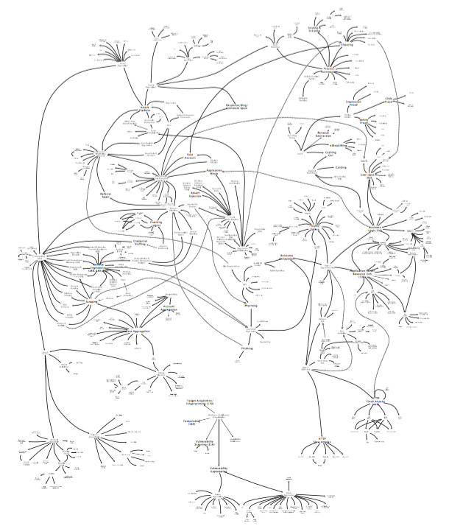
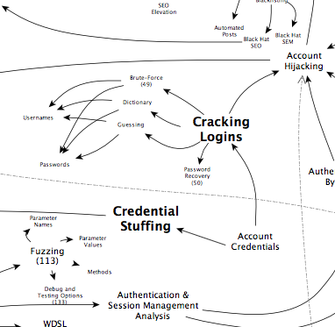
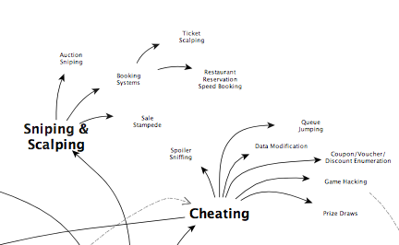
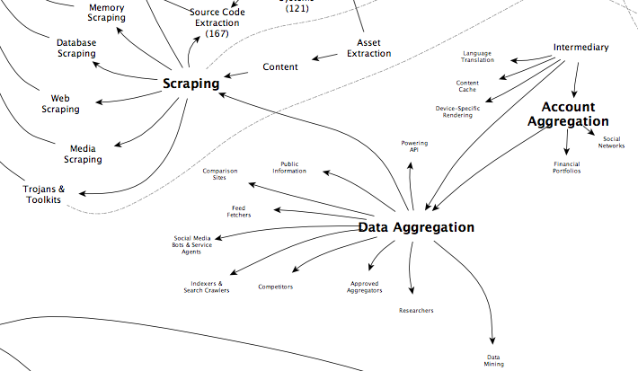
Threat Event Analysis
Notes:
Threat events, attack vectors, vulnerabilities and some motives – naming/scoping not critical.
40 or so clusters.
Examined relationships, overlaps and unique aspects.
Narrowed these down to provide candidate threat events (precise naming not really considered at this point). Eventually boiled these down to 19.
-
Those 600 original data points were first converted into a large-scale diagram to aid with distilling them down. This attempted to remove duplication and highlight interrelationships. The diagram can be found on the OWASP wiki.
Threat events
Attack vectors
Vulnerabilities
Motives
Naming not important, overlaps and duplication, and also things out-of-scope. Some of the out-of-scope were useful to define boundaries or to identify where similarities and differences exist.
[show poster]
NEXT
---

Slide 18
OAT-020 Account Aggregation
OAT-019 Account Creation
OAT-003 Ad Fraud
OAT-009 CAPTCHA Bypass
OAT-010 Card Cracking
OAT-001 Carding
OAT-012 Cashing Out
OAT-007 Credential Cracking
OAT-008 Credential Stuffing
OAT-015 Denial of Service
OAT-006 Expediting
OAT-004 Fingerprinting
OAT-018 Footprinting
OAT-005 Scalping
OAT-011 Scraping
OAT-016 Skewing
OAT-013 Sniping
OAT-017 Spamming
OAT-002 Token Cracking
OAT-014 Vulnerability Scanning
Ontology
Notes:
Full details on wiki and a v1 PDF. Also in print from Lulu. I’ll come to why 20 and not 19.
Not Top 20. 10-150. 30 for a while. Low point 19.
ID codes for identification and cross-referencing. Randomly assigned.
OAT=OWASP Automated Threat. 3 digits for growth, or maybe first digit=web, and 1=mobile app etc.
Prefix “Automated Web Application”. 12/cashing out not ATMs. 15/DoS not network DoS. Brief comments on two at top…
-
Full details of the finalised ontology threat events are provided in a handbook, available free as a PDF or Adobe InDesign, and at cost in print from Lulu.com [show handbook] - Here is the list of threat events ordered alphabetically.
This is not a top 10 or a top 20. 20 is a coincidence. Started with hundreds possibilities, and thought that >10 and <50 was reasonable. Thought it would be about 30 for a while. Low point 19. but ended up being 20.
To enable internal cross-referencing and referencing from elsewhere, each threat event has been given an identification (ID) code. This is a three-digit number prefixed by a hyphen and an abbreviation for OWASP Automated Threat (OAT) e.g. OAT-015. The ID codes were randomly assigned in an attempt to stop the ontology being seen as an ordered list, and also to ensure that neighbouring items are not necessarily related. Other cross-referencing is provided. Currently codes 001 to 020 are used, and it is expected the total number should be many fewer than fifty, unless many sub-items are ever added. Three digits, rather than two, were allotted in case the first digit is used for some other aspect in future, e.g. perhaps mobile application automated threat events could be 1xx, and 2xx for embedded software, etc.
The details at the end of the handbook categorises the threat events by:
Sectors Targeted - Sectors that are targeted more commonly than others for the specific threat event are highlighted in amber; this is currently just the author’s opinion, but the project is seeking information to define this aspect more accurately
Parties Affected - Whether individuals, groups of people, the application owner and other parties are most often affected adversely by the threat event; the threat event may affect other parties depending upon the application and its data; the parties affected, excluding subsequent further misuse
Data Commonly Misused - The types of data are web application specific; however, some threat events are more likely to occur for certain data types.
NEXT
---

Slide 19
OAT-020 Account Aggregation
OAT-006 Expediting
20 not 19
Notes:
Account Aggregation was in 40. But removed during sifting as it seemed to be Scraping.
Unique aspect intermediarisation and resulting disengagement added back as a separate term. And given next ID – 20.
Always tried to use existing term from literature, but created one new 6/Expediting. Number of sector/application specific threats realted to increased multi-step velocity. Difficult to put them together without a new name.
-
In all cases, “automated web application” could be used as a prefix to each name. Thus, for example, OAT-012 Cashing Out is concerned only with using web applications to obtain cash or goods; the ontology’s scope excludes cashing out using ATMs. OAT-015 Denial of Service is web application denial of service, and not an SSL/TLS or network DoS. When referencing the terms in other contexts, it may be useful to ensure that the web application scope is identified.
Some brief comments on two of these:
For a while during the development of the ontology, aggregation of user accounts was temporarily included within OAT-011 Scraping. However, during final review it was felt the aspects of customer opt in, the intermediarisation and resulting disengagement were sufficiently different from scraping to make it a separate term. Furthermore, it was a threat commonly seen in financial services. The threat event was added back in as OAT-020 Account Aggregation.
The only name newly created is OAT-006 Expediting, as there appeared to be a large number of sector-specific threats involving increased multi-step velocity that could otherwise not be aggregated together under a single name.
NEXT
---

Slide 20
Granularity
Naming
Fraud, legality and cheating
Ontology Creation
Notes:
Some names were too specific, and had to generalise them. E.g. Auction sniping -> Sniping
Some quite specific due to their prevalence in certain sectors. 1/Carding and also multi-vertical 19/Account Creation
Some larger buckets. If broken down, shard into very many functionality or vertical-specific threats. 11/Scraping, 17/Spamming and 14/Vulnerability scanning.
Avoid judgmental. Ad Fraud. Fraud is jurisdiction specific, also possibly contract specific. Data types and legislation.
A number might be considered cheating rather than illegal. 6/Expediting/ 5/Scalping, 16/Skewing and 13/Sniping.
-
Whenever possible, an existing term already used in literature or industry usage was preferred, but in many cases, it was difficult to identify such a term; as such, in some cases a more generic version had to be used. A good example of this is OAT-013 Sniping, where auction sniping is the most commonly cited case; it was determined that the characteristics of sniping also occur in threat events against other types of applications, and the selected name was thus made more general. A handful of threat event names in the ontology are very specific since they are reported to occur frequently (e.g. OAT-001 Carding, OAT-019 Account Creation). Others are larger buckets (e.g. OAT-011 Scraping, OAT-017 Spamming, OAT-014 Vulnerability Scanning) that cannot be broken down easily without sharding the threat events into a multitude of sector-specific and function-specific examples.
Fraud, legality and cheating - In general, the ontology tries to avoid the use of judgmental words like fraud. But in one case, the industry accepted term for the threat event includes this word: OAT-003 Ad Fraud. In legal terms, whether an action is fraudulent depends on legislation and jurisdiction. Some of the events in this ontology may be illegal actions in some jurisdictions, or may be prohibited in a commercial contract. This will also depend upon the types of data handled, regulation of the application and its owner, and application-specific mandates like terms of use.
Rather than being illegal, some threat events will be considered cheating by other normal users, including OAT-006 Expediting, OAT-005 Scalping, OAT-016 Skewing and OAT-013 Sniping. These will be sector, application and culturally specific views, but can undermine user trust and the reputation of the application and its owner.
NEXT
---

Slide 21
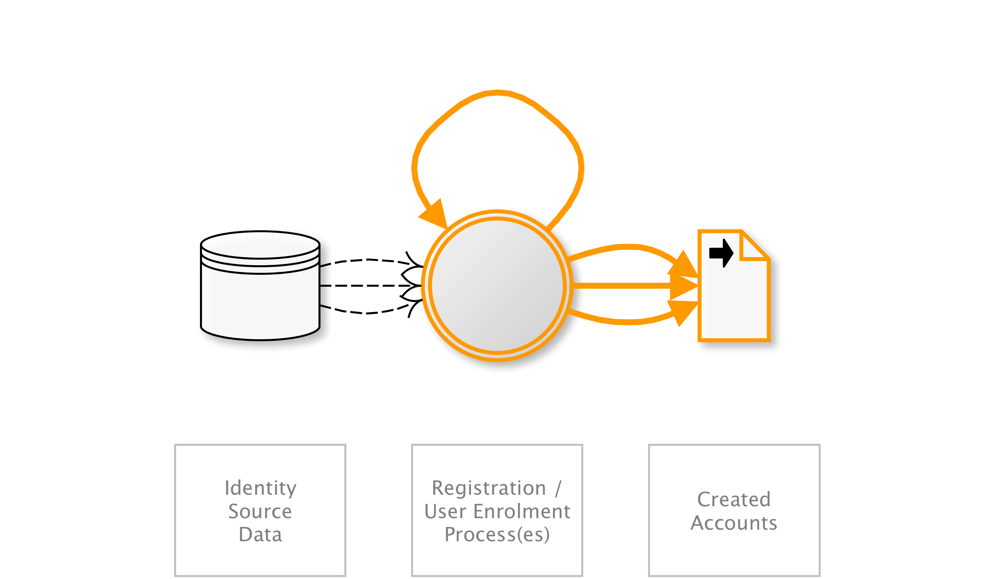
OAT-019 Account Creation
Create multiple accounts for subsequent misuse.
AKA Account pharming; Fake account; Fake social media account creation; Impersonator bot; Massive account registration; New account creation; Registering many user accounts
OAT-019 Account Creation
Notes:
Bulk account creation, and sometimes profile population, by using the application’s account sign-up processes. The accounts are subsequently misused for generating content spam, laundering cash and goods, spreading malware, affecting reputation, causing mischief, and skewing search engine optimisation (SEO), reviews and surveys.
Account Creation generates new accounts - see OAT-007 Credential Cracking and OAT-008 Credential Stuffing for threat events that use existing accounts.
Education/Entertainment/Financial/Retail/Social networking
Application owner
Authentication credentials/Other business data

Slide 22
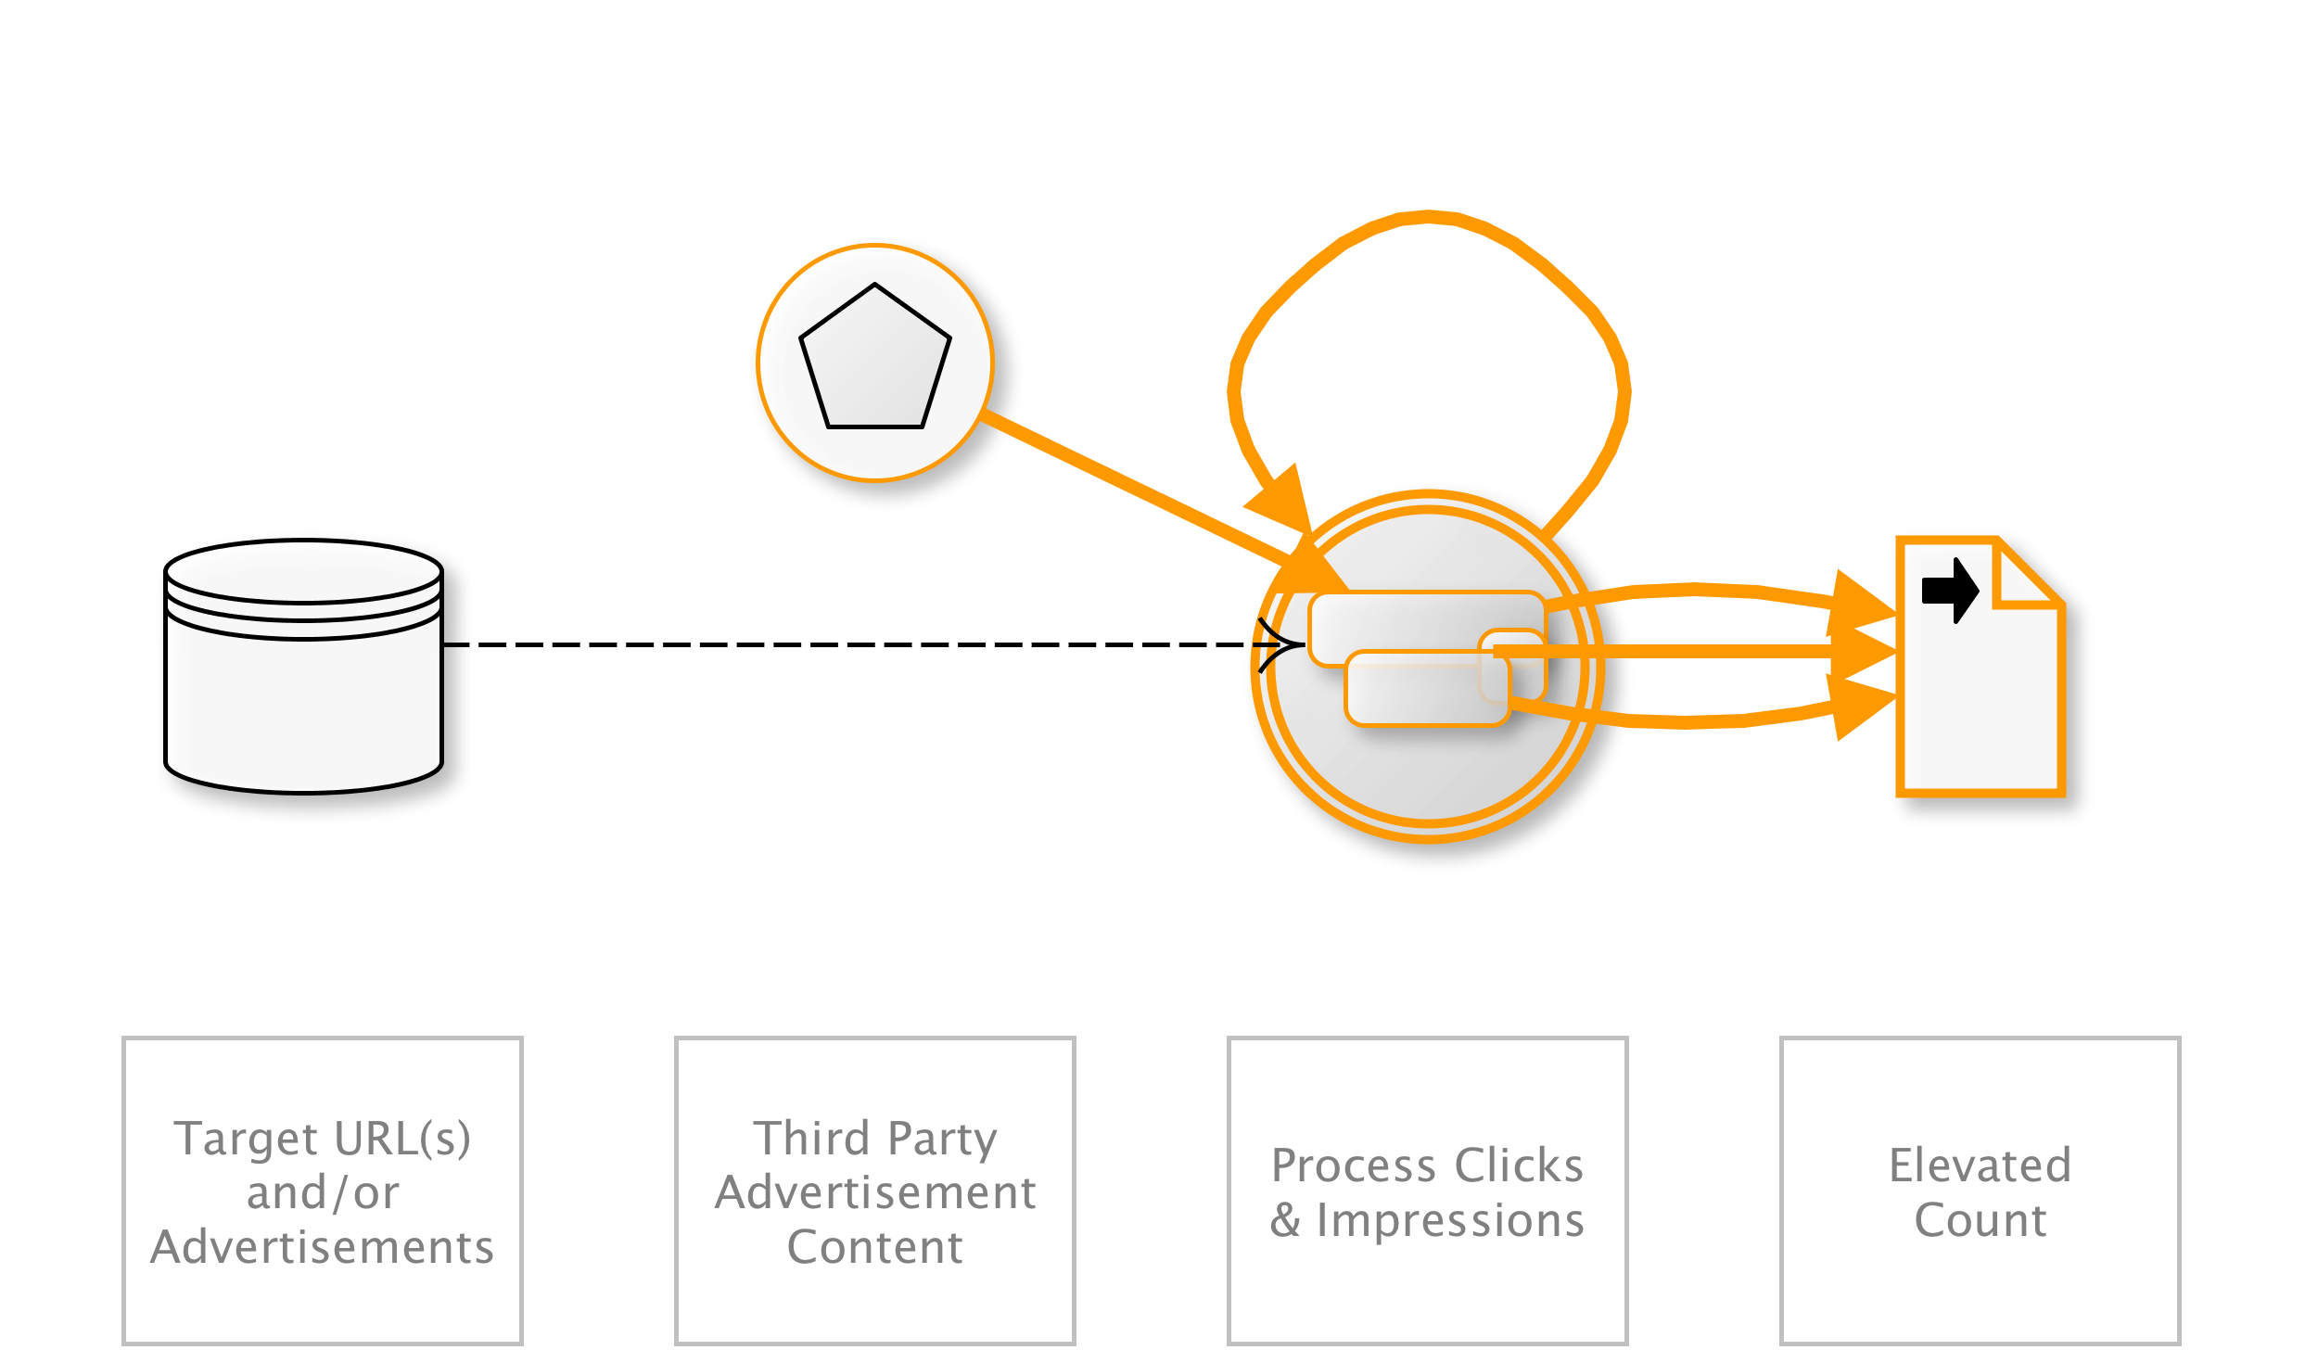
OAT-003 Ad Fraud
False clicks and fraudulent display of web-placed advertisements.
AKA Advert fraud; Adware traffic; Click bot; Click fraud; Hit fraud; Impression fraud; Pay per click advertising abuse; Phoney ad traffic
OAT-003 Ad Fraud
Notes:
Falsification of the number of times an item such as an advert is clicked on, or the number of times an advertisement is displayed. Performed by owners of web sites displaying ads, competitors and vandals.
See OAT-016 Skewing instead for similar activity that does not involve web-placed advertisements.
Entertainment/Financial/Health/Retail/Technology/Social networking
Application owner/Third parties
Other business data

Slide 23
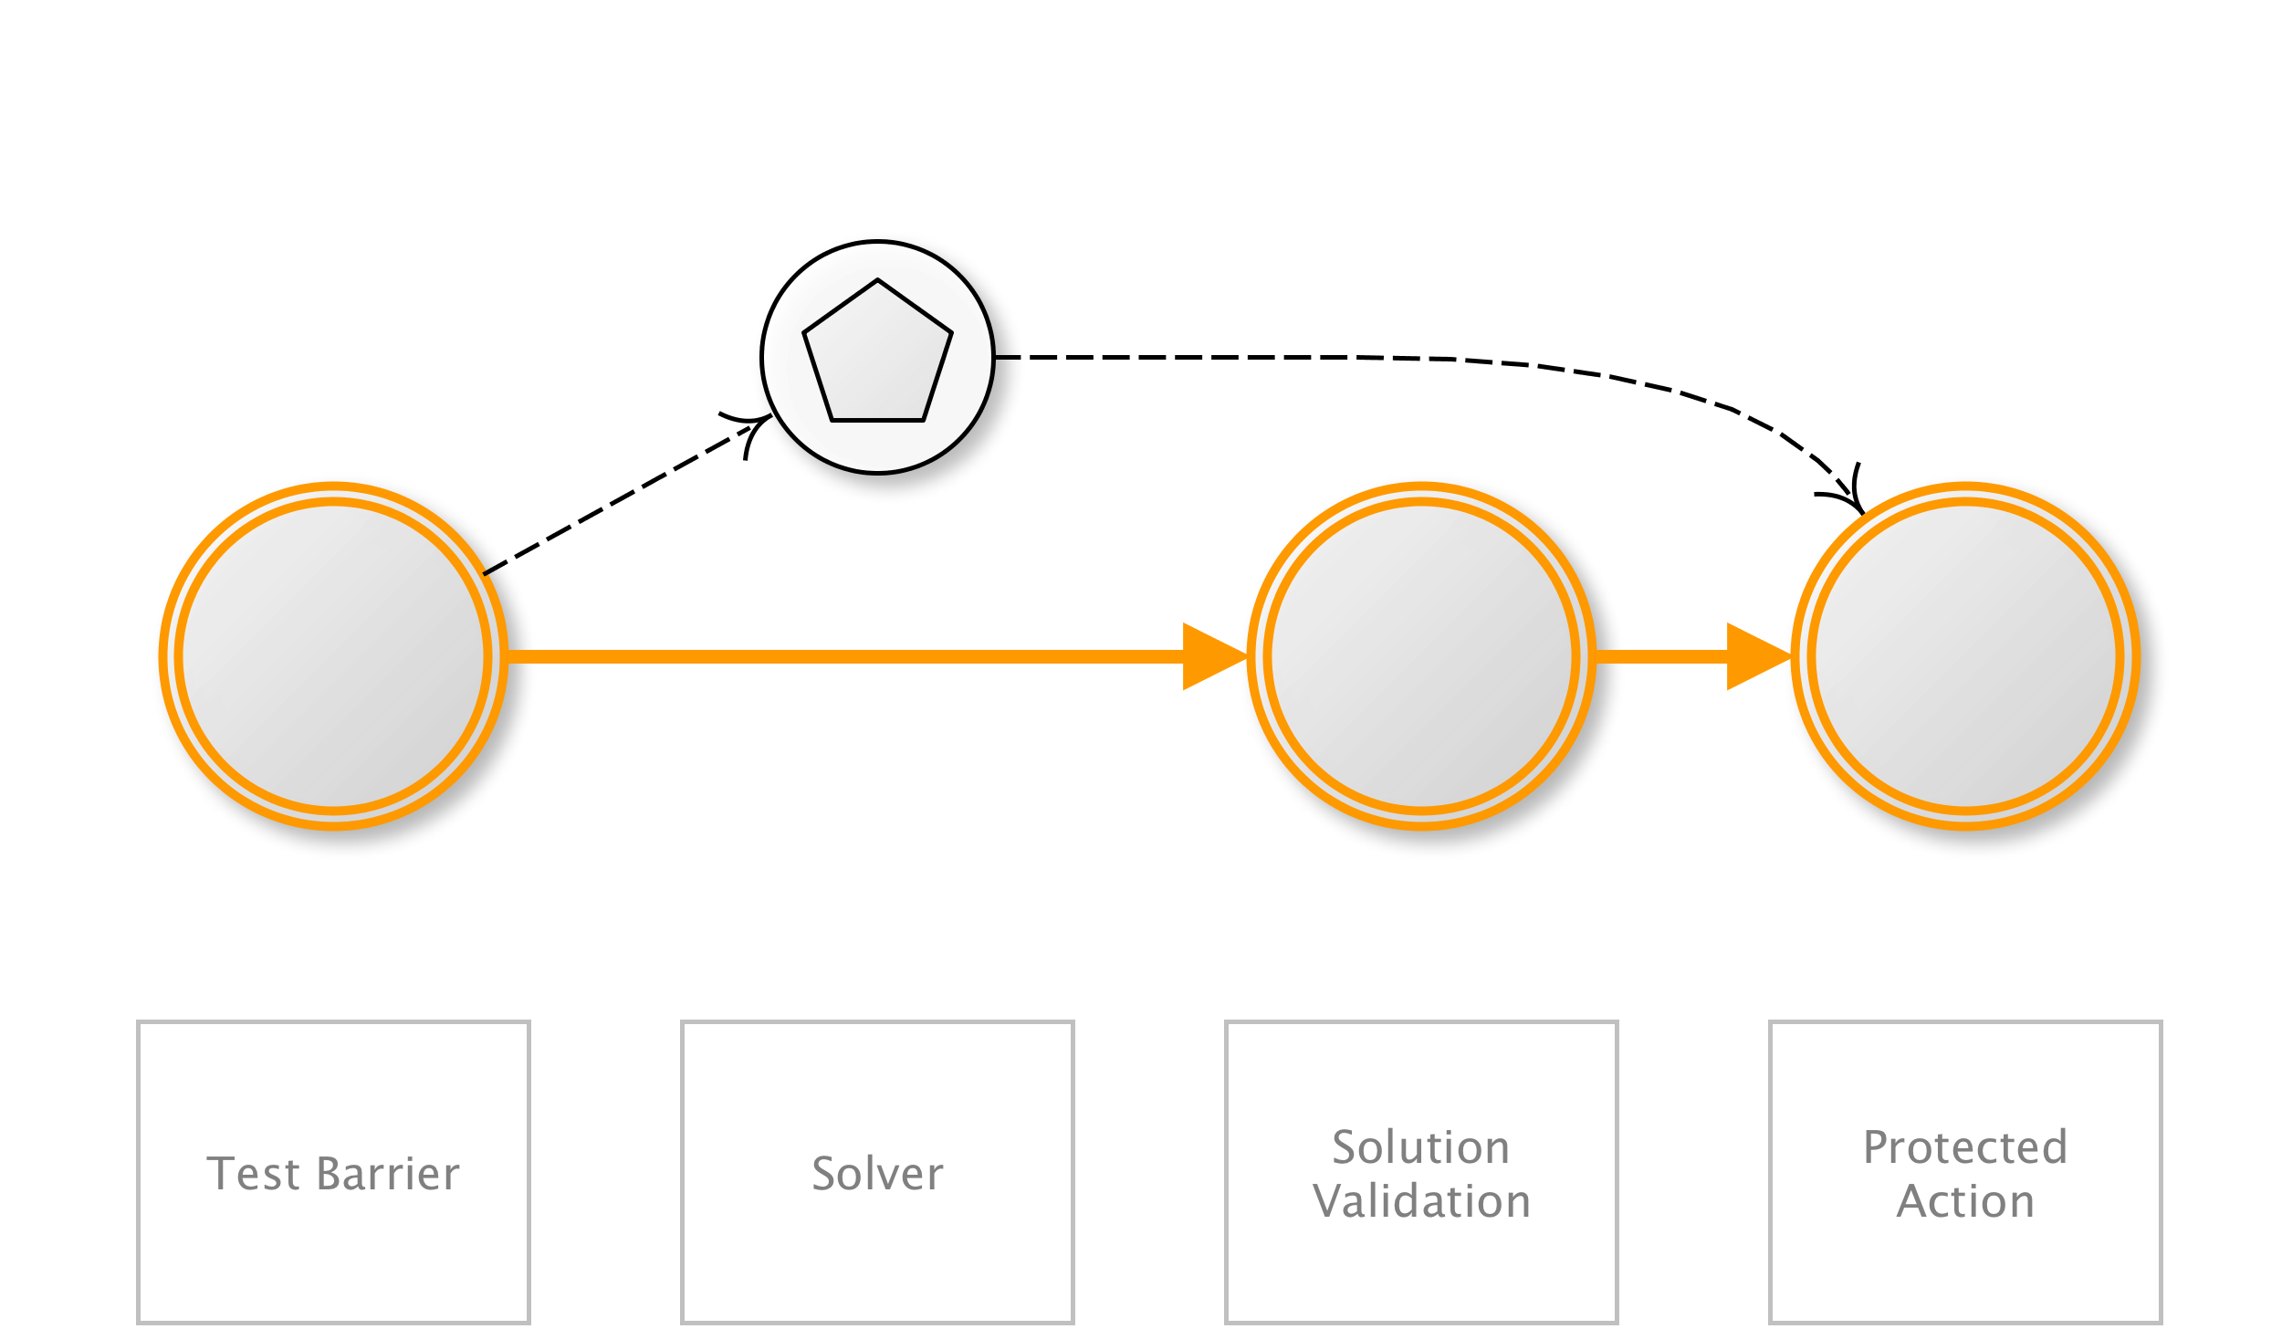
OAT-009 CAPTCHA Bypass
Solve anti-automation tests.
AKA Breaking CAPTCHA; CAPTCHA breaker; CAPTCHA breaking; CAPTCHA decoding; CAPTCHA solver; CAPTCHA solving; Puzzle solving
OAT-009 CAPTCHA Bypass
Notes:
Completely Automated Public Turing test to tell Computers and Humans Apart (CAPTCHA) challenges are used to distinguish normal users from bots. Automation is used in an attempt to analyse and determine the answer to visual and/or aural CAPTCHA tests and related puzzles. Apart from conventional visual and aural CAPTCHA, puzzle solving mini games or arithmetical exercises are sometimes used. Some of these may include context-specific challenges.
The process that determines the answer may utilise tools to perform optical character recognition, or matching against a prepared database of pre-generated images, or using other machine reading, or human farms.
Entertainment/Entertainment/Financial/Government/Retail/Social networking
Application owner
Authentication credentials

Slide 24
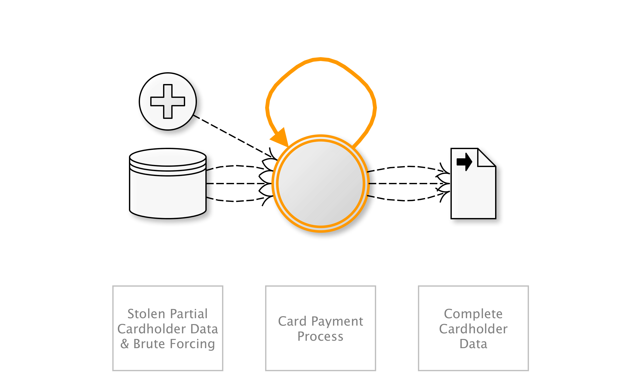
OAT-010 Card Cracking
Identify missing start/expiry dates and security codes for stolen payment card data by trying different values.
AKA Brute forcing credit card information; Card brute forcing; Credit card cracking
OAT-010 Card Cracking
Notes:
Look at a handful. Each ID, name, short summary, diagram and other names/examples.
Brute force attack against application payment card processes to identify the missing values for start date, expiry date and/or card security code (CSC), also referred to in many ways, including card validation number 2 (CVN2), card validation code (CVC), card verification value (CV2) and card identification number (CID).
When these values are known as well as the Primary Account Number (PAN), OAT-001 Carding is used to validate the details, and OAT-012 Cashing Out to obtain goods or cash.
Retail
Many users/Application owner/Third parties
Payment cardholder data
NEXT
---

Slide 25
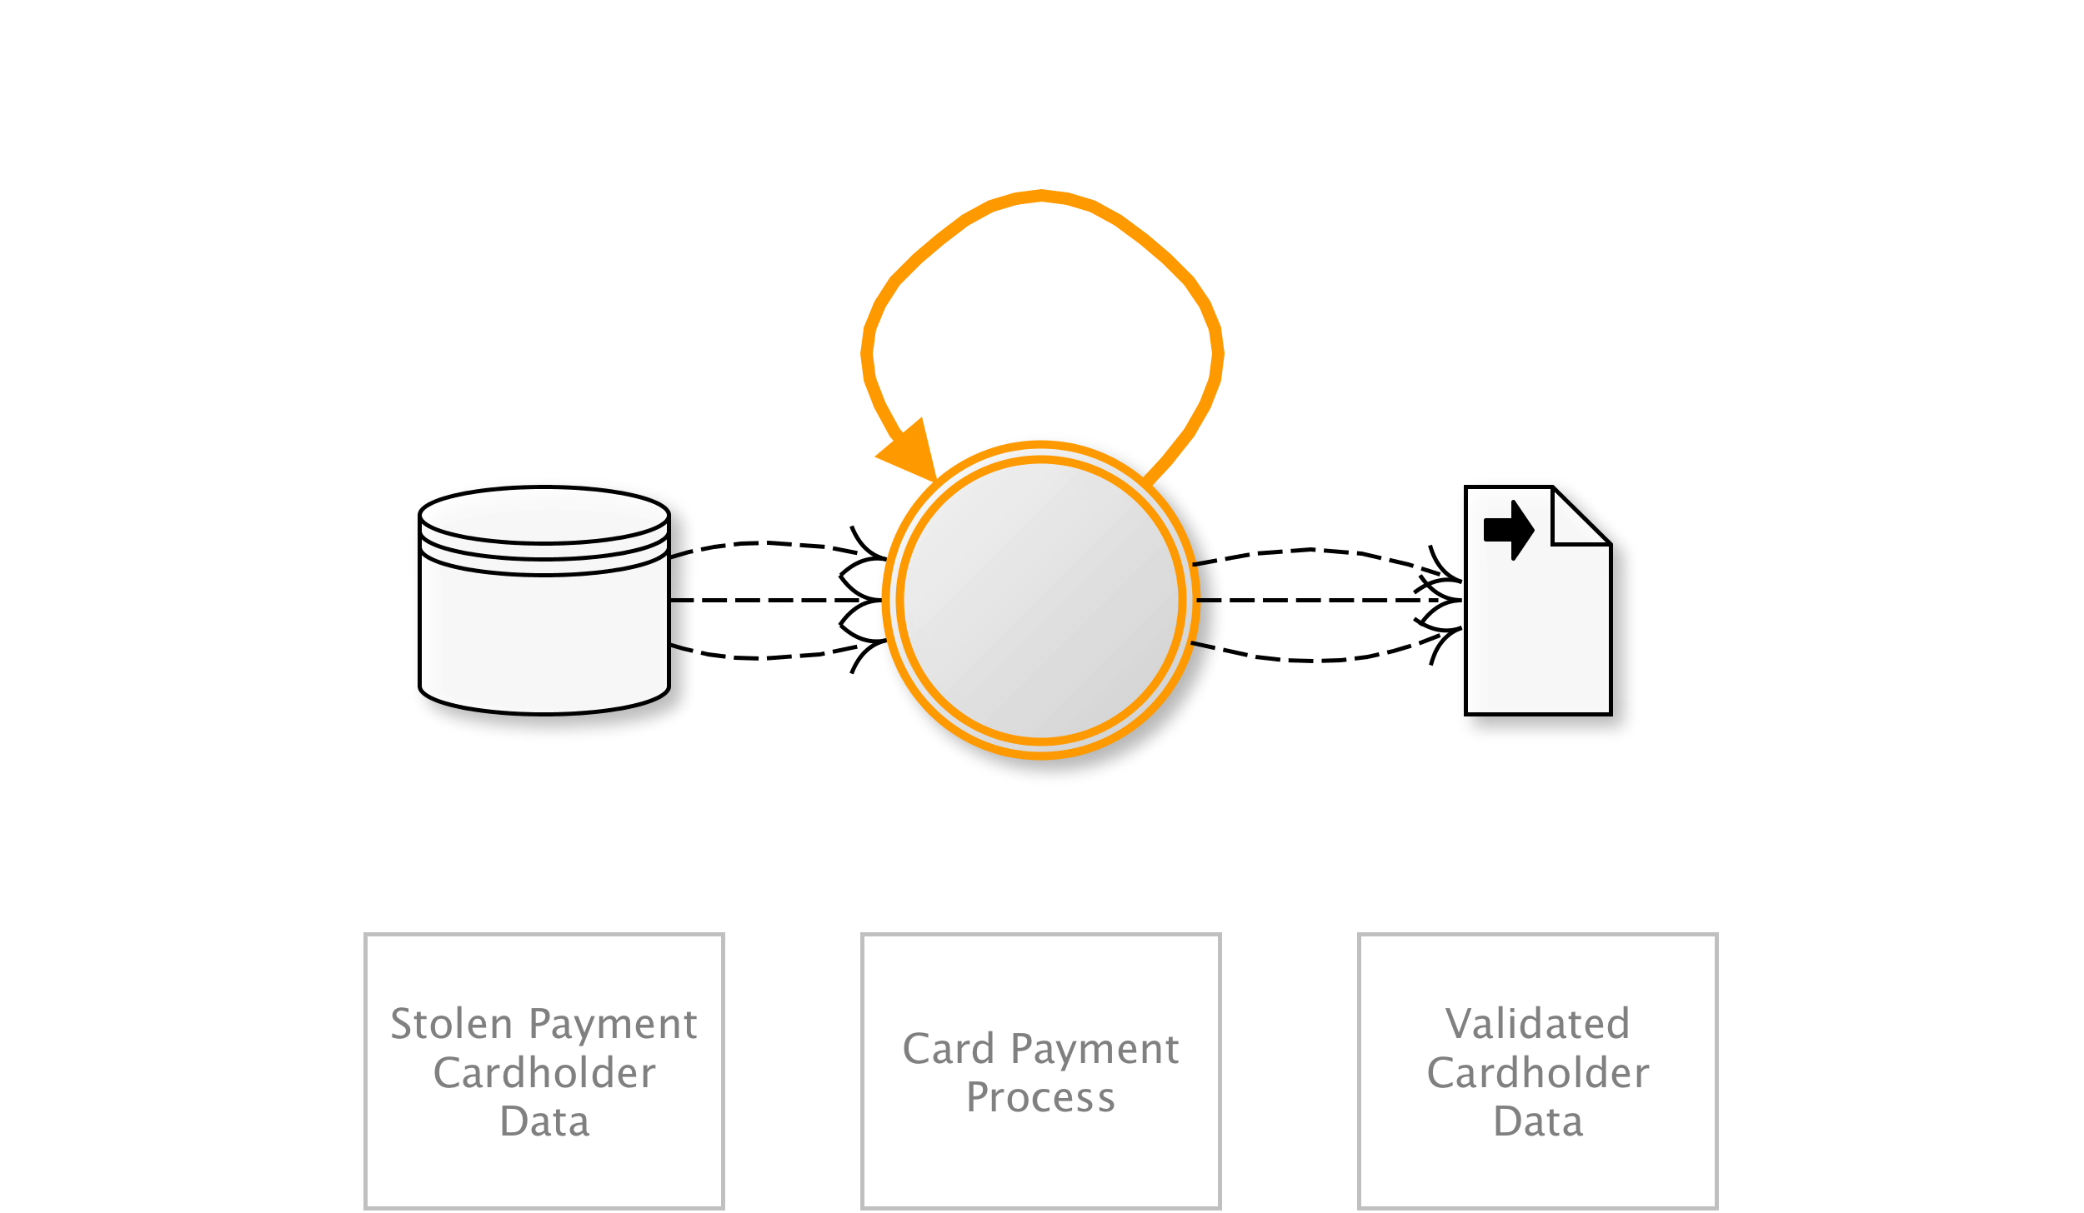
OAT-001 Carding
Multiple payment authorisation attempts used to verify the validity of bulk stolen payment card data.
AKA Card stuffing; Credit card stuffing; Card verification
OAT-001 Carding
Notes:
Lists of full credit and/or debit card data are tested against a merchant’s payment processes to identify valid card details. The quality of stolen data is often unknown, and Carding is used to identify good data of higher value. Payment cardholder data may have been stolen from another application, stolen from a different payment channel, or acquired from a criminal marketplace.
When partial cardholder data is available, and the expiry date and/or security code are not known, the process is OAT-010 Card Cracking instead. The use of stolen cards to obtain cash or goods is OAT-012 Cashing Out.
Entertainment/Retail
Many users/Application owner/Third parties
Payment cardholder data
NEXT
---

Slide 26
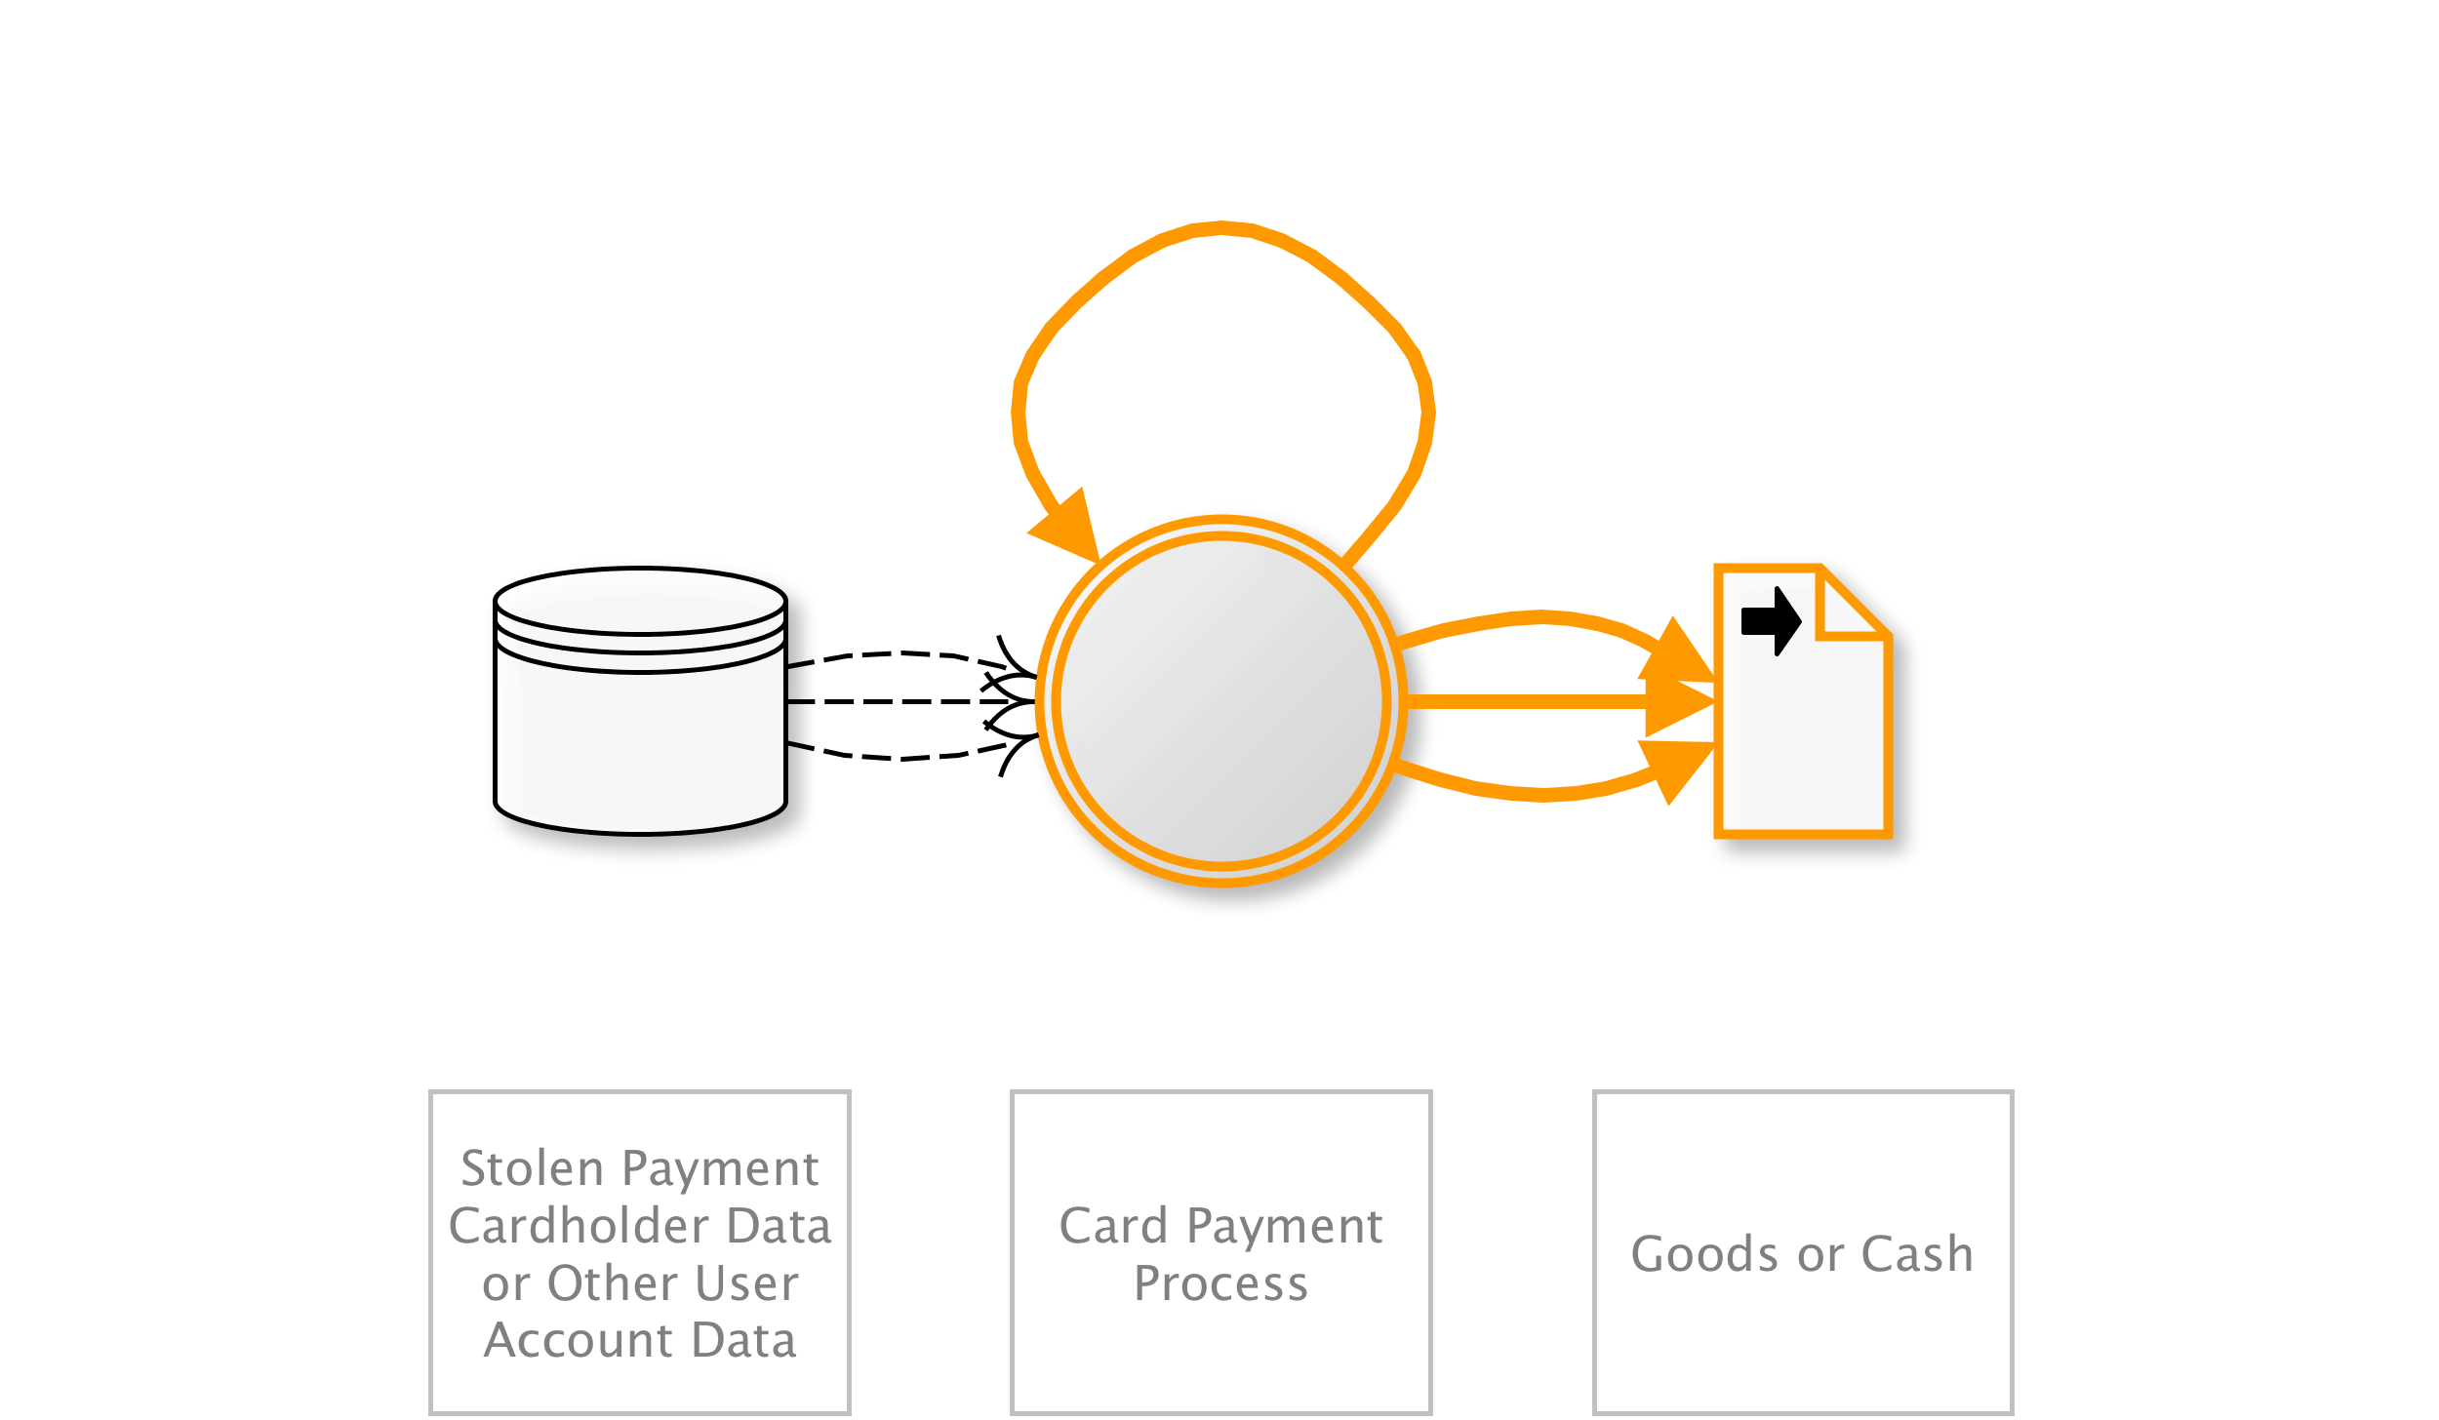
OAT-012 Cashing Out
Buy goods or obtain cash utilising validated stolen payment card or other user account data.
AKA Money laundering; Online credit card fraud; Online payment card fraud; Refund fraud; Stolen identity refund fraud (SIRF)
OAT-012 Cashing Out
Notes:
Obtaining currency or higher-value merchandise via the application using stolen, previously validated payment cards or other account login credentials. Cashing Out sometimes may be undertaken in conjunction with product return fraud. For financial transactions, this is usually a transfer of funds to a mule’s account. For payment cards, this activity may occur following OAT-001 Carding of bulk stolen data, or OAT-010 Card Cracking, and the goods are dropped at a reshipper’s address. The refunding of payments via non-financial applications (e.g. tax refunds, claims payment) is also included in Cashing Out.
Obtaining other information of value from the application is instead OAT-011 Scraping.
Entertainment/Financial/Government/Retail
Many users/Application owner/Third parties
Authentication credentials/Payment cardholder data/Other financial data

Slide 27
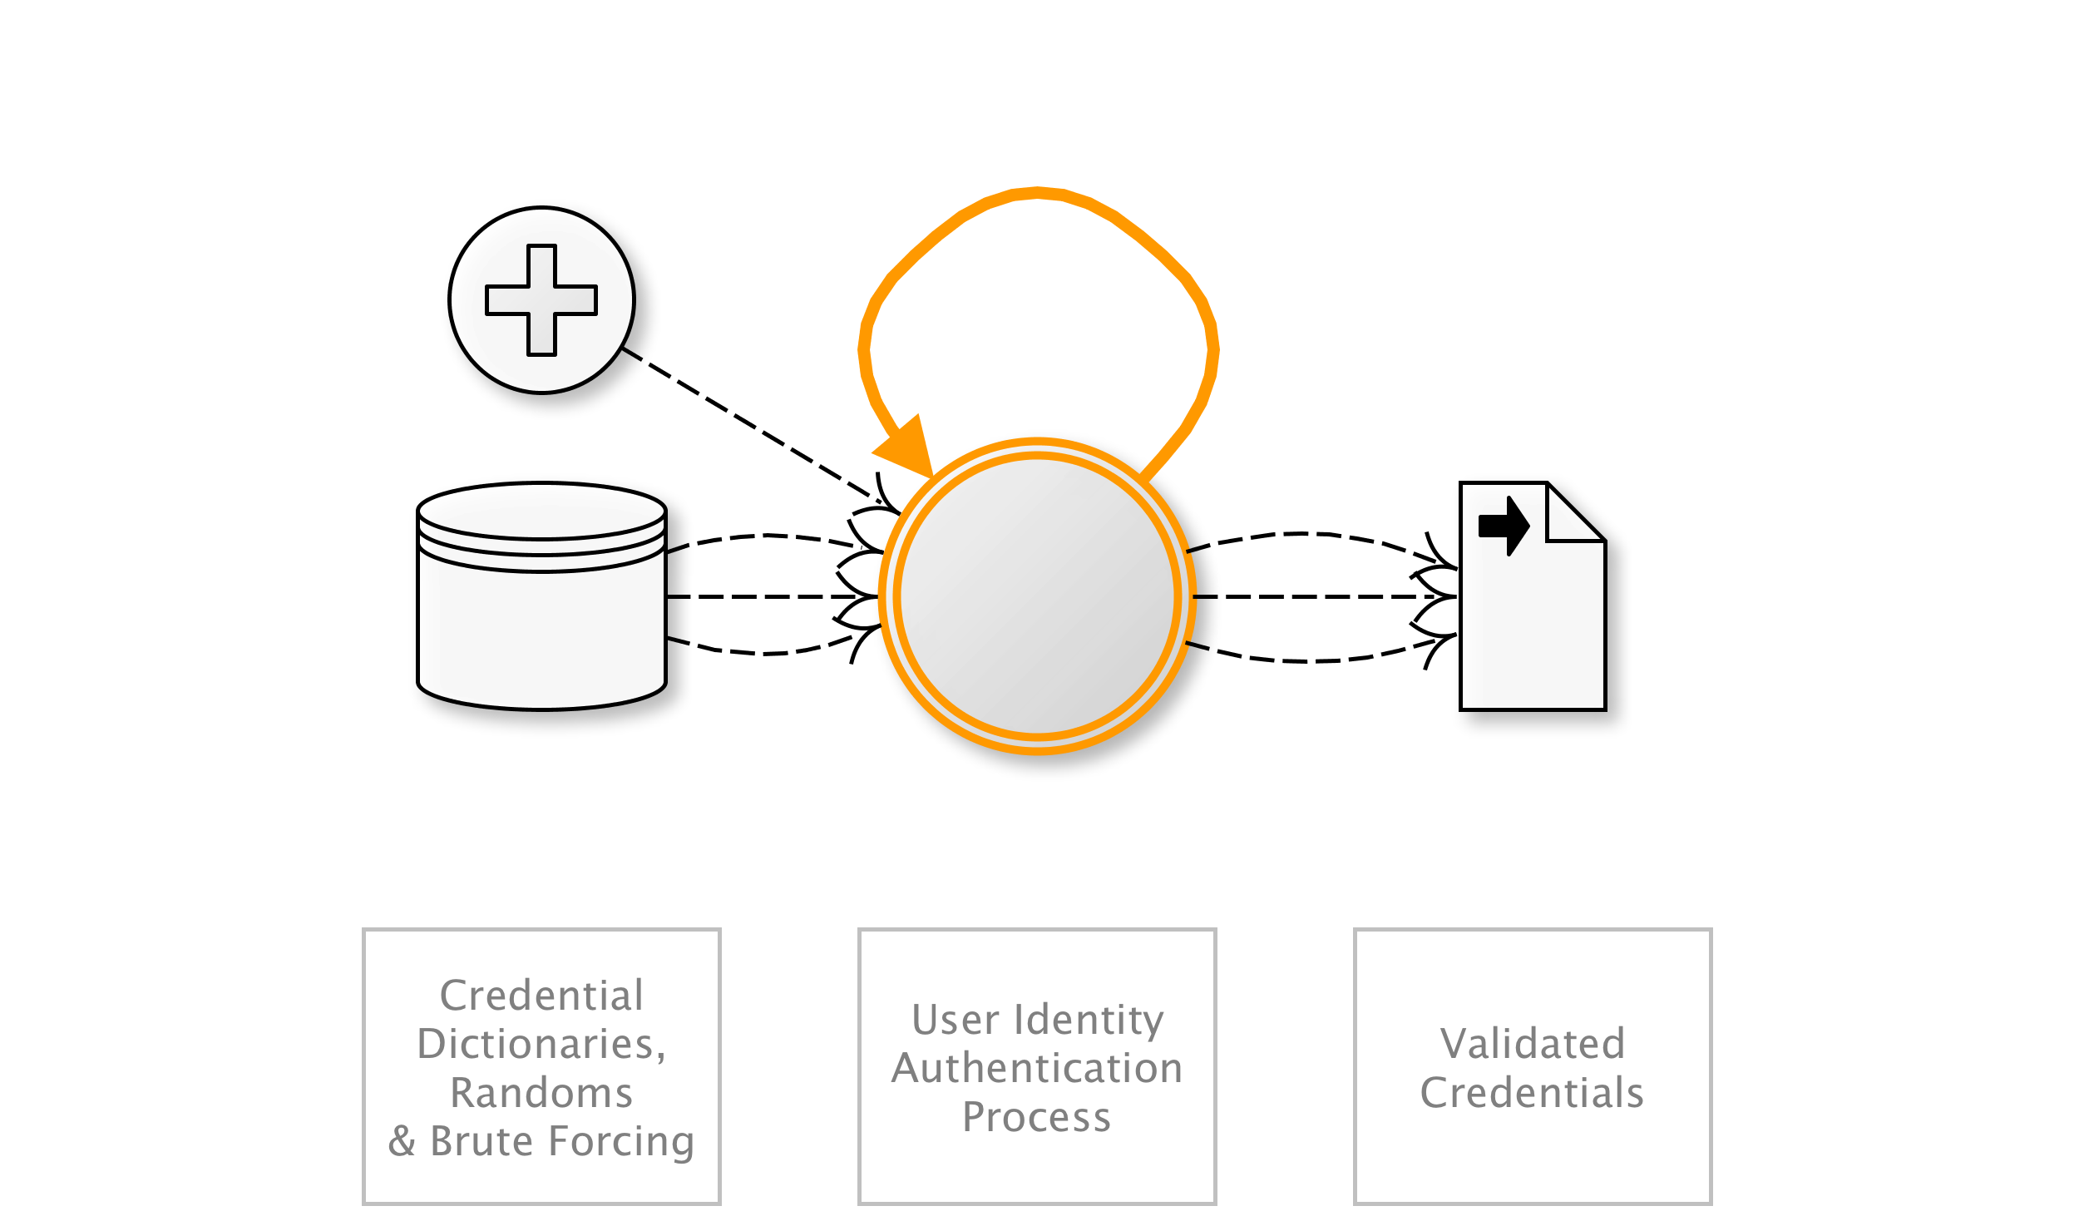
OAT-007 Credential Cracking
Identify valid login credentials by trying different values for usernames and/or passwords.
AKA Brute-force attacks against sign-in; Brute forcing log-in credentials; Brute-force password cracking; Cracking login credentials; Password brute-forcing; Password cracking; Reverse brute force attack; Username cracking; Username enumeration
OAT-007 Credential Cracking
Notes:
Brute force, dictionary (word list) and guessing attacks used against authentication processes of the application to identify valid account credentials. This may utilise common usernames or passwords, or involve initial username evaluation.
The use of stolen credential sets (paired username and passwords) to authenticate at one or more services is OAT-008 Credential Stuffing.
(all)
Many users/Application owner
Authentication credentials

Slide 28
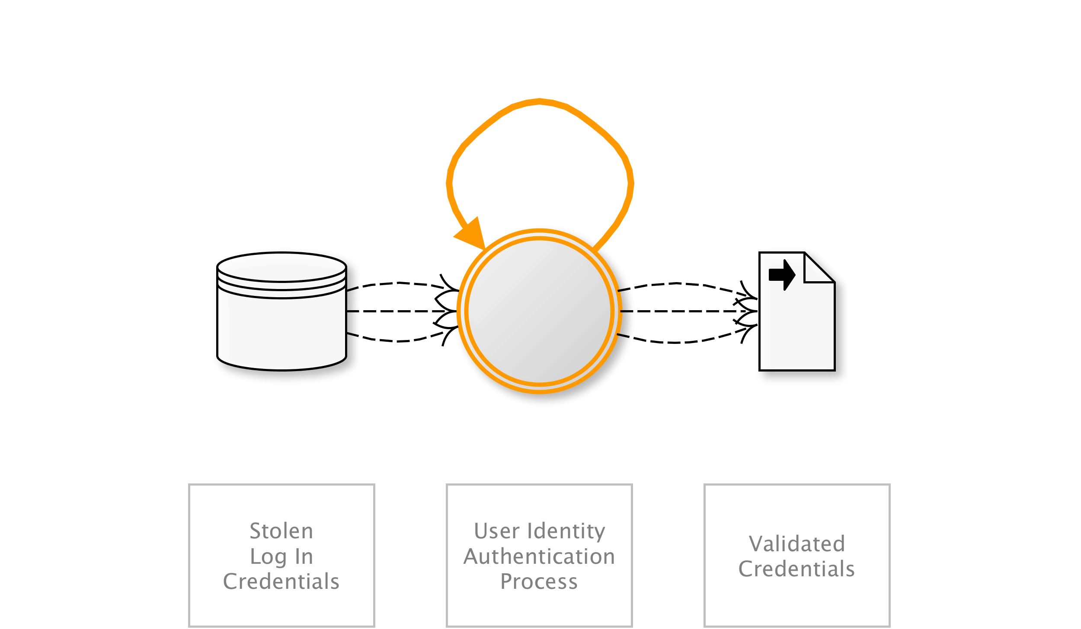
OAT-008 Credential Stuffing
Mass log in attempts used to verify the validity of stolen username/password pairs.
AKA Account checker attack; Account checking; Account takeover; Account takeover attack; Login Stuffing; Password list attack; Password re-use; Stolen credentials; Use of stolen credentials
OAT-008 Credential Stuffing
Notes:
Lists of authentication credentials stolen from elsewhere are tested against the application’s authentication mechanisms to identify whether users have re-used the same login credentials. The stolen usernames (often email addresses) and password pairs could have been sourced directly from another application by the attacker, purchased in a criminal marketplace, or obtained from publicly available breach data dumps.
Unlike OAT-007 Credential Cracking, Credential Stuffing does not involve any brute-forcing or guessing of values; instead credentials used in other applications are being tested for validity.
Entertainment/Financial/Government/Retail/Social networking
Many users/Application owner
Authentication credentials
NEXT
---

Slide 29
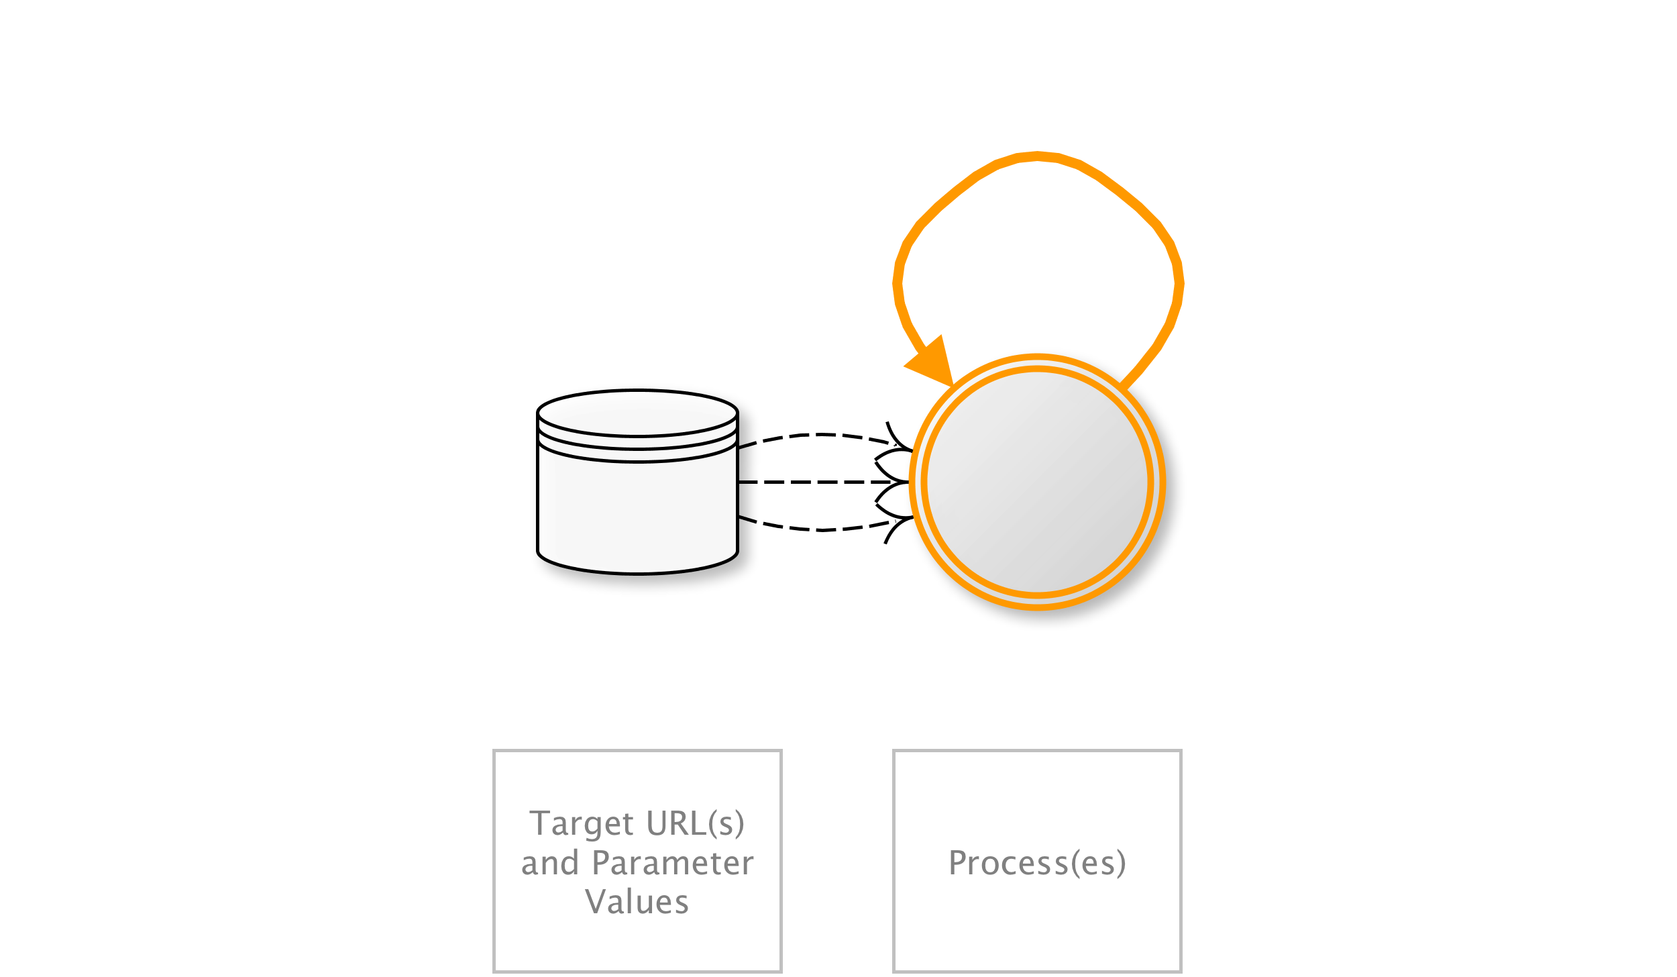
OAT-015 Denial of Service
Target resources of the application and database servers, or individual user accounts, to achieve denial of service (DoS).
AKA Account lockout; App layer DDoS; Asymmetric resource consumption (amplification); Business logic DDoS; Cash overflow; Forced deadlock; Hash DoS; Inefficient code; Indexer DoS; Large files DoS; Resource depletion, locking or exhaustion; Sustained client engagement
OAT-015 Denial of Service
Notes:
Usage may resemble legitimate application usage, but leads to exhaustion of resources such as file system, memory, processes, threads, CPU, and human or financial resources. The resources might be related to web, application or databases servers or other services supporting the application, such as third party APIs, included third-party hosted content, or content delivery networks (CDNs). The application may be affected as a whole, or the attack may be against individual users such as account lockout.
This ontology’s scope excludes other forms of denial of service that affect web applications, namely HTTP Flood DoS (GET, POST, Header with/without TLS), HTTP Slow DoS, IP layer 3 DoS, and TCP layer 4 DoS. Those protocol and lower layer aspects are covered adequately in other taxonomies and lists.
Entertainment/Financial/Government/Retail/Technology/Social networking
Few individual users/Many users/Application owner
NA

Slide 30
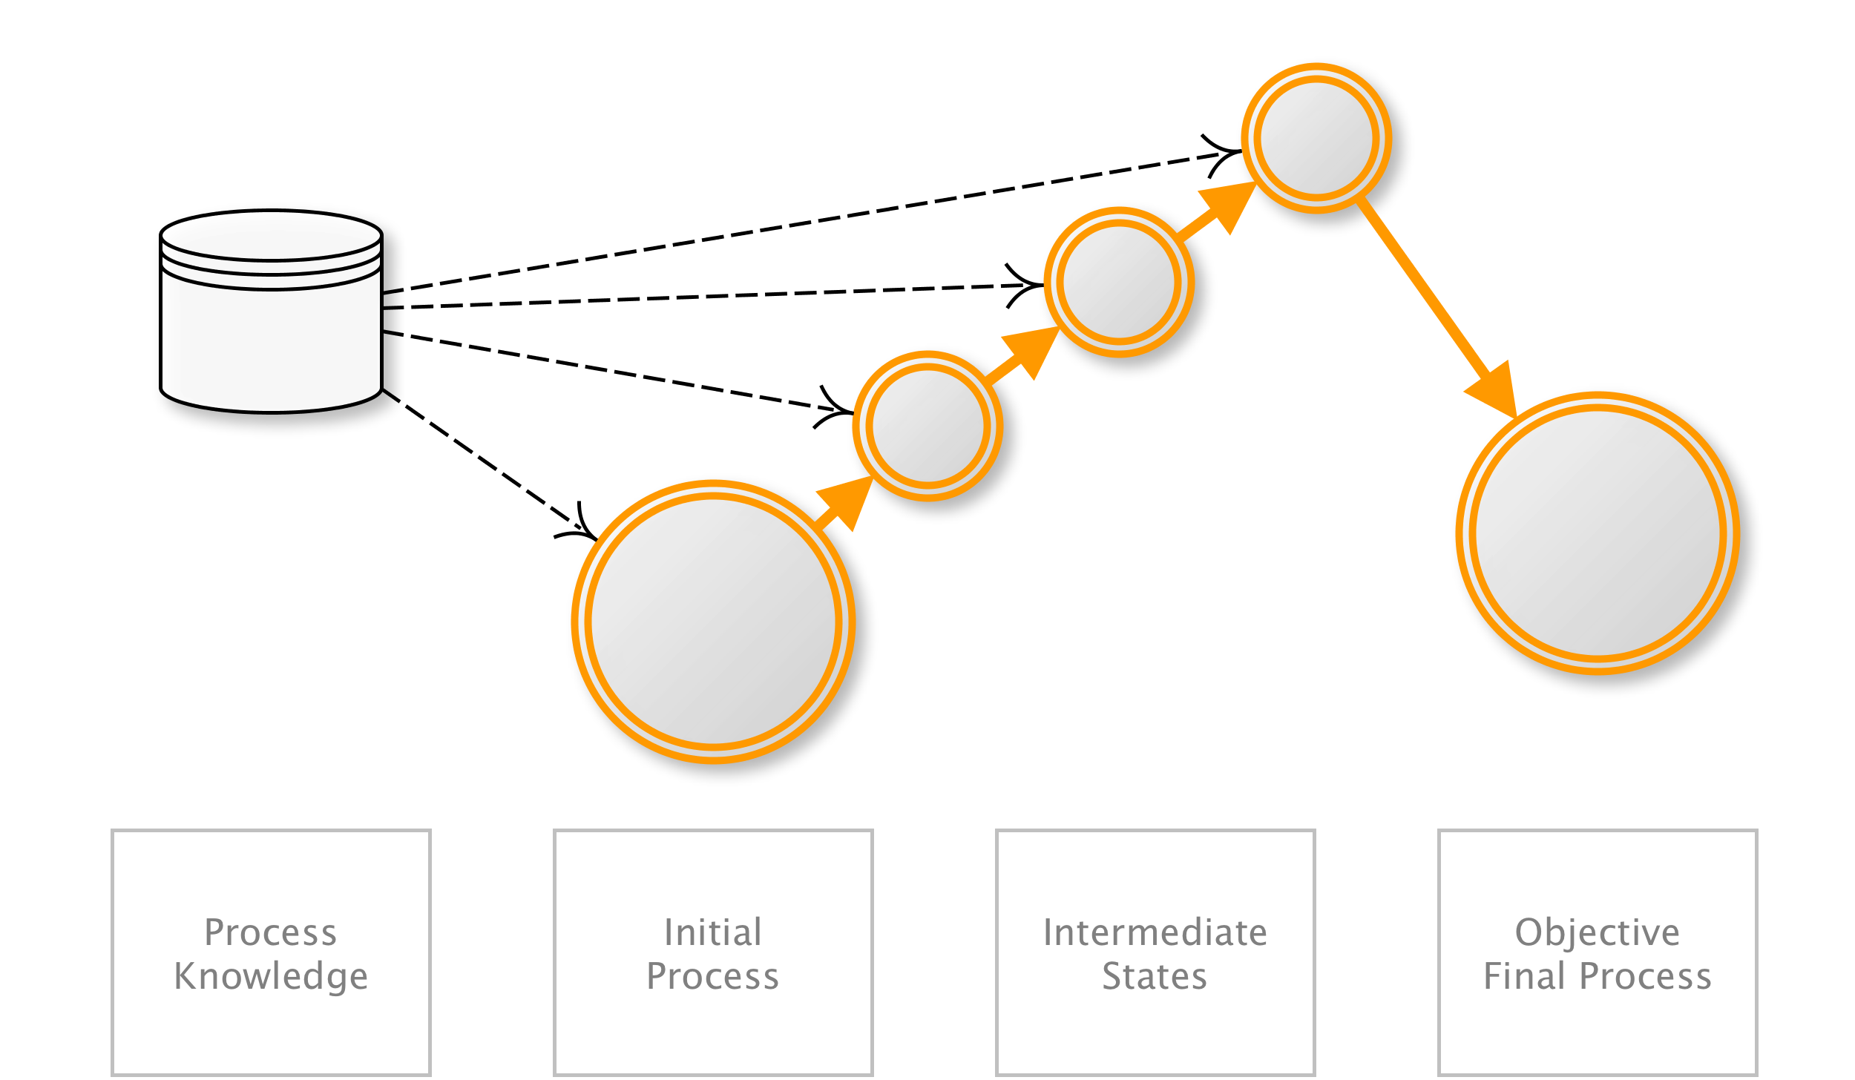
OAT-006 Expediting
Perform actions to hasten progress of usually slow, tedious or time-consuming actions on behalf of a person.
AKA Algorithmic trading; Automated stock trading; Betting automation; Game automation; Gaming bot; Gold farming; Financial instrument dealing; High frequency trading; Purchase automation; Ticketing automation; Trading automation; Virtual wealth generation
OAT-006 Expediting
Notes:
Using speed to violate explicit or implicit assumptions about the application’s normal use to achieve unfair individual gain, often associated with deceit and loss to some other party.
In contrast to OAT-016 Skewing which affects metrics, Expediting is purely related to faster progression through a series of application processes. And OAT-017 Spamming is different to Expediting, since the focus of spam is to add information, and may not involve the concept of process progression.
Entertainment/Financial/Government/Retail/Social networking
Many users/Application owner
Other business data
NEXT
---

Slide 31
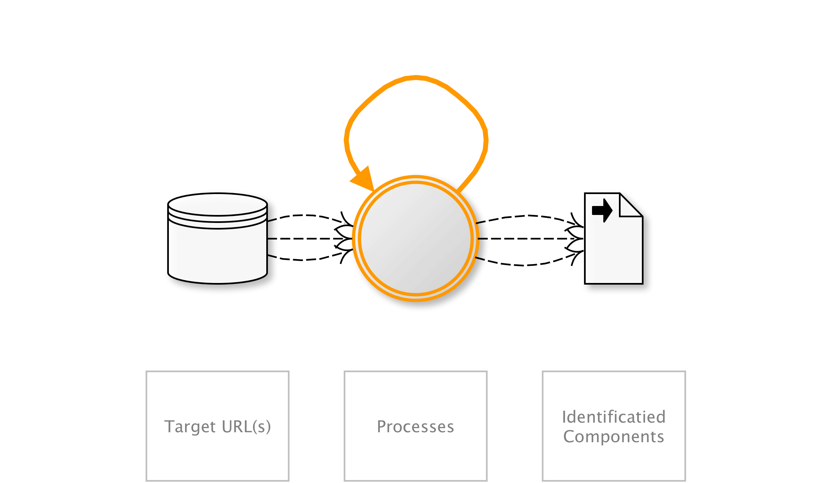
OAT-004 Fingerprinting
Elicit information from the web, application and database servers about the supporting software and framework types and versions.
AKA Google dorking; Google hacking; Shodaning; Target acquisition; Target scanning; Finding potentially vulnerable applications; Reconnaissance; URL harvesting; Web application fingerprinting
OAT-004 Fingerprinting
Notes:
Specific requests are sent to the application eliciting information in order to profile the application. This probing typically examine HTTP header names and values, session identifier names and formats, contents of error page messages, URL path case sensitivity, URL path patterns, file extensions, and whether software-specific files and directories exist. Fingerprinting is often reliant on information leakage and this profiling may also reveal some network architecture/topology. The fingerprinting may be undertaken without any direct usage of the application e.g. by quering a store of exposed application properties such as held in a search engine’s index.
Fingerprinting seeks to identity application components, whereas OAT-018 Footprinting is a more detailed analysis of how the application works.
All sectors
No specific party affected
Public information

Slide 32
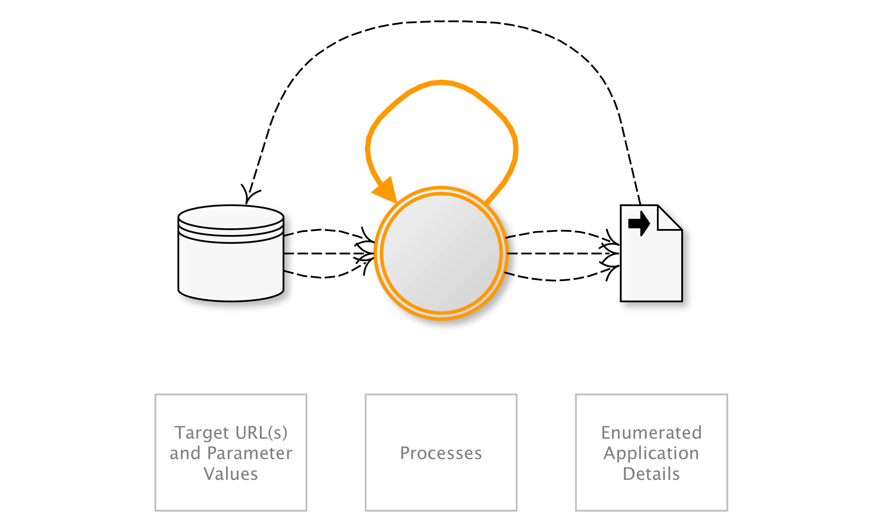
OAT-018 Footprinting
Probe and explore application to identify its constituents and properties.
AKA Application analysis; API discovery; Application enumeration; Automated scanning; CGI scanning; Crawler; Crawling; Excavation; Forced browsing; Forceful browsing; Fuzzing; Micro service discovery; Scanning; Spidering; WSDL scanning
OAT-018 Footprinting
Notes:
Information gathering with the objective of learning as much as possible about the composition, configuration and security mechanisms of the application. Unlike Scraping, Footprinting is an enumeration of the application itself, rather than the data. It is used to identify all the URL paths, parameters and values, and process sequences (i.e. to determine entry points, also collectively called the attack surface). As the application is explored, additional paths will be identified which in turn need to be examined.
Footprinting can also include brute force, dictionary and guessing of file and directory names. Fuzzing may also be used to identify further application resources and capabilities. However, it does not include attempts to exploit weaknesses.
(all)
Application owner
Other business data/Public information

Slide 33
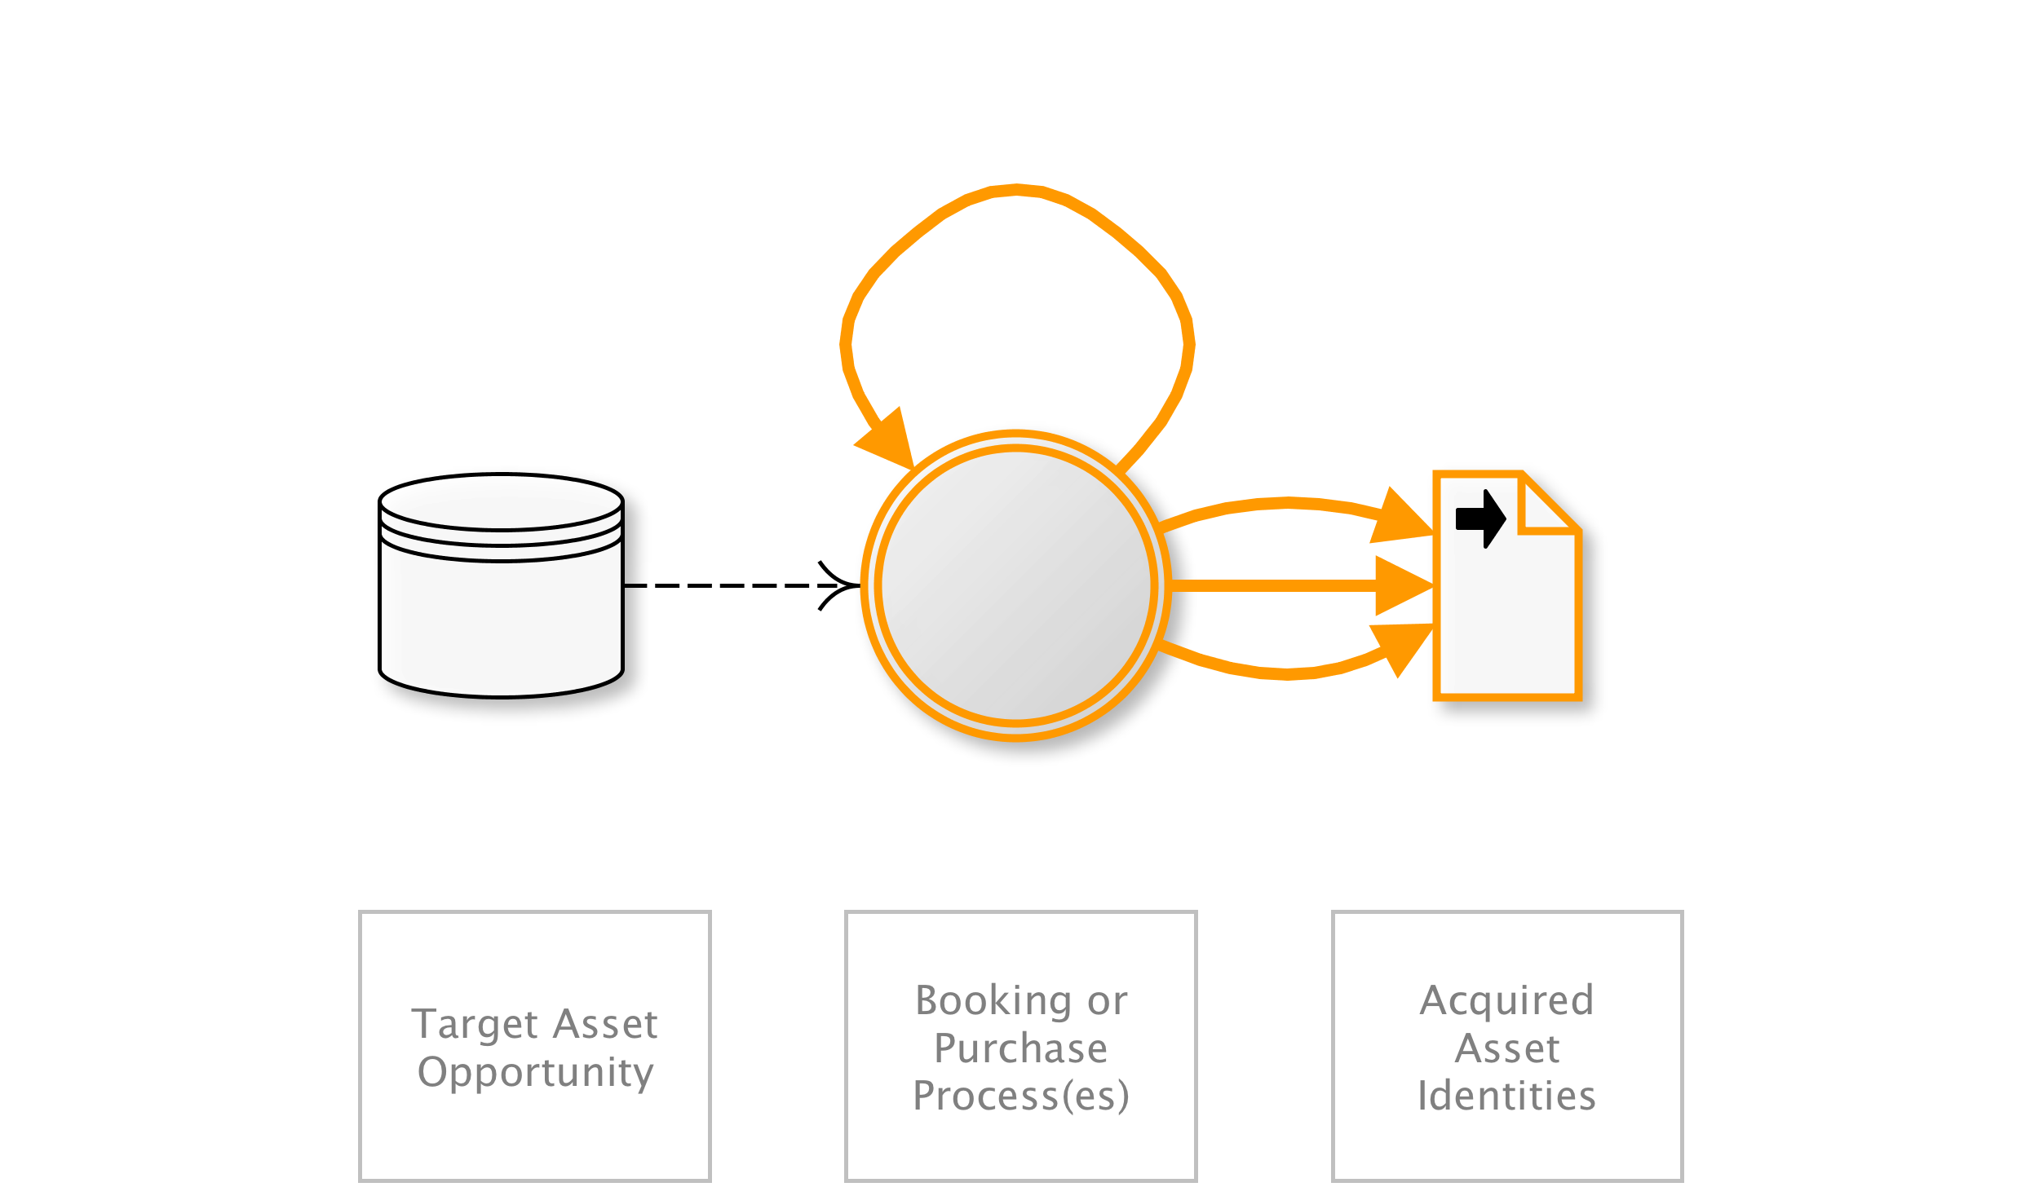
OAT-005 Scalping
Obtain limited-availability and/or preferred goods/services by unfair methods.
AKA Bulk purchase; Purchase automaton; Purchase bot; Restaurant table/hotel room reservation speed-booking; Queue jumping; Sale stampede; Ticket resale; Ticket scalping; Ticket touting
OAT-005 Scalping
Notes:
Mass acquisition of goods or services using the application in a manner that a normal user would be unable to undertake manually.
Although Scalping may include monitoring awaiting availability of the goods or services, and then rapid action to beat normal users to obtain these, Scalping is not a “last minute” action like OAT-013 Sniping, nor just related to automation on behalf of the user such as in OAT-006 Expediting. This is because Scalping includes the additional concept of limited availability of sought-after goods or services, and is most well known in the ticketing business where the tickets acquired are then resold later at a profit by the scalpers/touts. This can also lead to a type of user denial of service since the goods or services become unavailable rapidly.
Entertainment/Financial/Retail
Many users/Application owner
-
NEXT
---

Slide 34

OAT-011 Scraping
Collect application content and/or other data for use elsewhere.
AKA API provisioning; Bargain hunting; Comparative shopping; Content scraping; Data aggregation; Database scraping; Farming; Harvesting; Meta search scraper; Mining; Mirroring; Pagejacking; Powering APIs; Ripping; Scraper bot; Screen scraping; Search engine bot; Social media bot
OAT-011 Scraping
Notes:
Collecting accessible data and/or processed output from the application. Some scraping may use fake or compromised accounts, or the information may be accessible without authentication. The scraper may attempt to read all accessible paths and parameter values for web pages and APIs, collecting the responses and extracting data from them. Scraping may occur in real time, or be more periodic in nature. Some Scraping may be used to gain insight into how it is constructed and operates - perhaps for cryptanalysis, reverse engineering, or session analysis.
When another application is being used as an intermediary between the user(s) and the real application, see OAT-020 Account Aggregation. If the intent is to obtain cash or goods, see OAT-012 Cashing Out instead.
(all)
Many users/Application owner
(all)

Slide 35
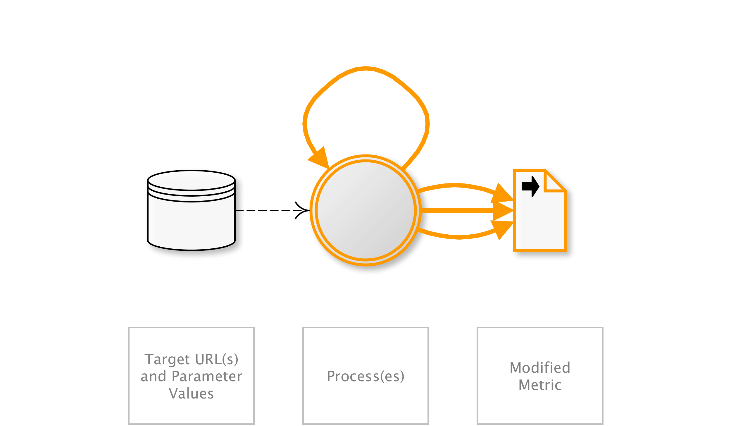
OAT-016 Skewing
Repeated link clicks, page requests or form submissions intended to alter some metric.
AKA Biasing KPIs; Boosting friends, visitors, and likes; Click fraud; Election fraud; Hit count fraud; Market distortion; Metric and statistic skewing; Page impression fraud; Poll fraud; Poll skewing; Poll/voting subversion; Rating/review skewing; SEO; Stock manipulation; Survey skewing
OAT-016 Skewing
Notes:
Automated repeated clicking or requesting or submitting content, affecting application-based metrics such as counts and measures of frequency and/or rate. The metric or measurement may be visible to users (e.g. betting odds, likes, market pricing, visitor count, poll results, reviews) or hidden (e.g. application usage statistics, business performance indicators). Metrics may affect individuals as well as the application owner, e.g. user reputation, influence others, gain fame, or undermine someone else’s reputation.
For malicious alteration of digital advertisement metrics, see OAT-003 Ad Fraud instead.
(all)
(all)
Other personal data/Other business data/Public information

Slide 36
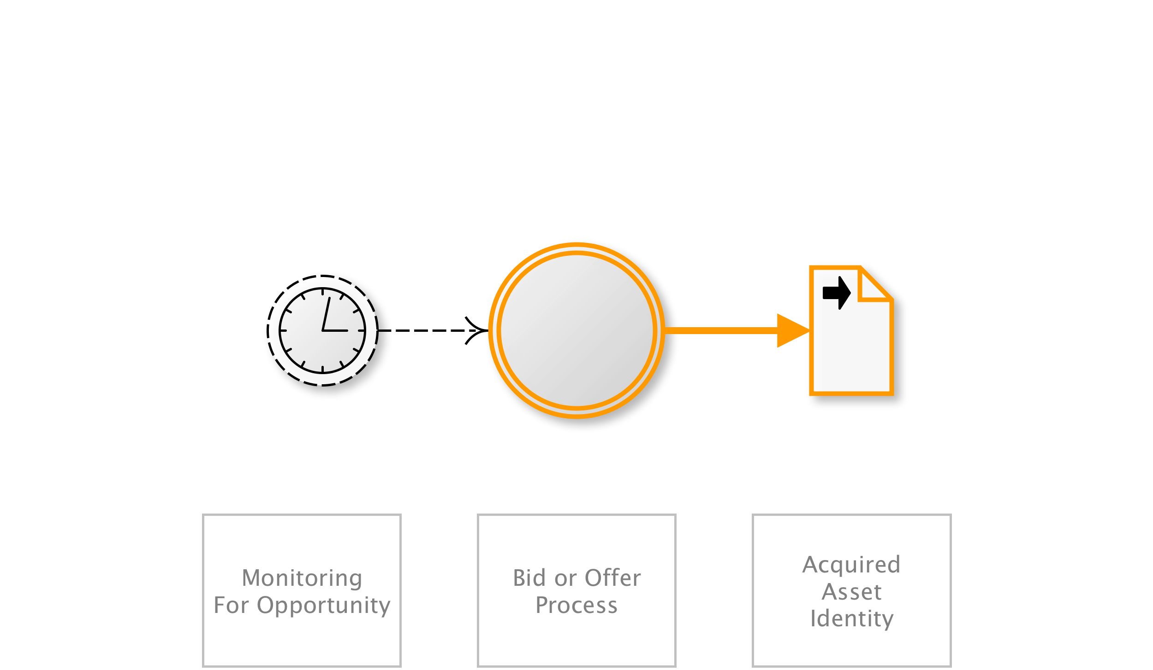
OAT-013 Sniping
Last minute bid or offer for goods or services.
AKA Auction sniping; Bid sniper; Front-running; Last look; Last minute bet; Timing attack
OAT-013 Sniping
Notes:
The defining characteristic of Sniping is an action undertaken at the latest opportunity to achieve a particular objective, leaving insufficient time for another user to bid/offer. Sniping can also be the automated exploitation of system latencies in the form of timing attacks. Careful timing and prompt action are necessary parts. It is most well known as auction sniping, but the same threat event can be used in other types of applications. Sniping normally leads to some dis-benefit for other users, and sometimes that might be considered a form of denial of service.
In contrast, OAT-005 Scalping is the acquisition of limited availability of sought-after goods or services, and OAT-006 Expediting is the general hastening of progress.
Entertainment/Financial/Retail
Few individual users/Application owner/Third parties
Other financial data/Other business data
I hope that gives you a flavour for the threat events – all are detailed in the handbook. I’d like to illustrate how these relate to some better-known classifications....
NEXT
---

Slide 37
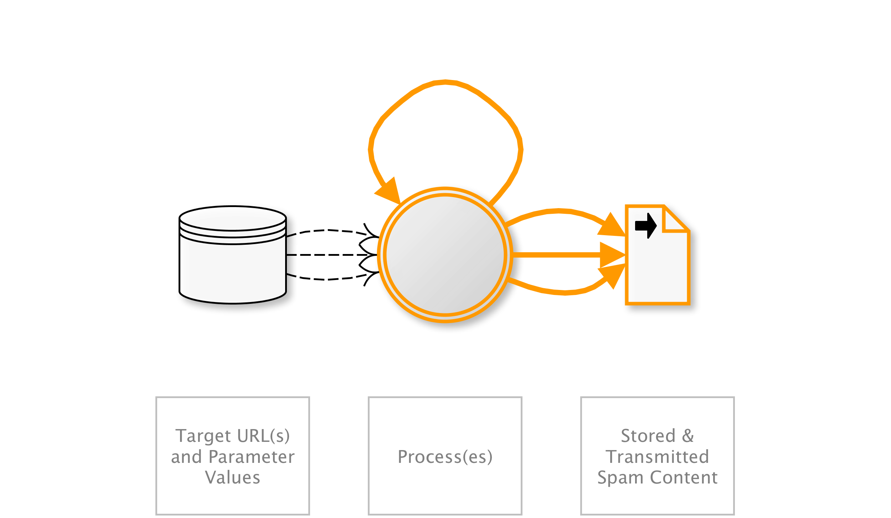
OAT-017 Spamming
Malicious or questionable information addition that appears in public or private content, databases or user messages.
AKA Blog spam; Bulletin board spam; Comment spam; Content spam; Content spoofing; Form spam; Forum spam; Guestbook spam; Referrer spam; Response form spam; Review spam; SEO spam; Spam crawlers; Spam 2.0; Spambot; Wiki spam; Twitter spam
OAT-017 Spamming
Notes:
Malicious content can include malware, IFRAME distribution, photographs & videos, advertisements, referrer spam and tracking/surveillance code. The content might be less overtly malicious but be an attempt to cause mischief, undertake search engine optimisation (SEO) or to dilute/hide other posts.
The mass abuse of broken form-to-email and form-to-SMS functions to send messages to unintended recipients is not included in this threat event, or any other in this ontology, since those are considered to be the exploitation of implementation flaws alone.
For multiple use that distorts metrics, see OAT-016 Skewing instead.
Entertainment/Retail/Social networking
(all)
Other business data/Public information

Slide 38
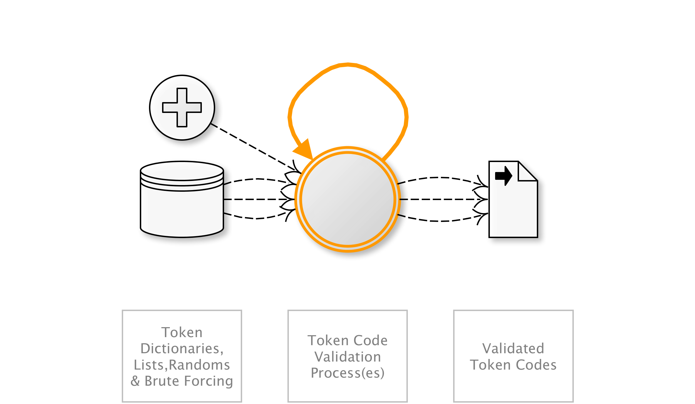
OAT-002 Token Cracking
Mass enumeration of coupon numbers, voucher codes, discount tokens, etc.
AKA Coupon guessing; Voucher, gift card and discount enumeration
OAT-002 Token Cracking
Notes:
Identification of valid token codes providing some form of user benefit within the application. The benefit may be a cash alternative, a non-cash credit, a discount, or an opportunity such as access to a limited offer.
For cracking of usernames, see OAT-007 Credential Cracking instead.
Entertainment/Financial/Retail
Application owner/Third parties
Other business data

Slide 39
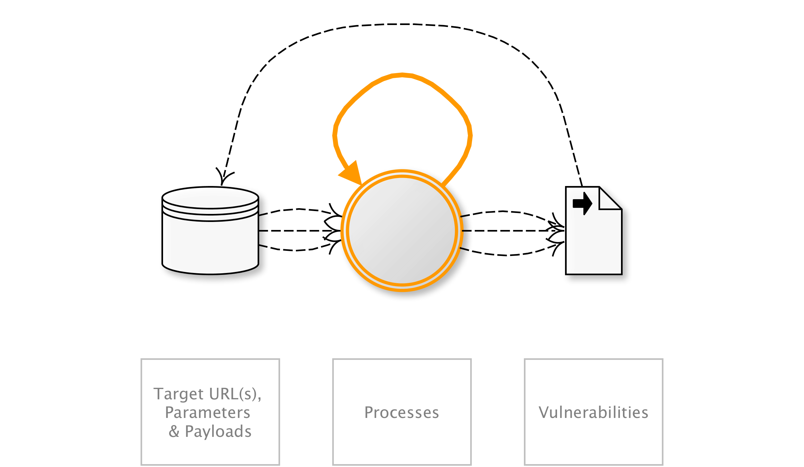
OAT-014 Vulnerability Scanning
Crawl and fuzz application to identify weaknesses and possible vulnerabilities.
AKA Active/Passive scanning; Application-specific vulnerability discovery; Identifying vulnerable content management systems (CMS) and CMS components; Known vulnerability scanning; Malicious crawling; Vulnerability reconnaissance
OAT-014 Vulnerability Scanning
Notes:
Systematic enumeration and examination of identifiable, guessable and unknown content locations, paths, file names, parameters, in order to find weaknesses and points where a security vulnerability might exist. Vulnerability Scanning includes both malicious scanning and friendly scanning by an authorised vulnerability scanning engine. It differs from OAT-011 Scraping in that its aim is to identify potential vulnerabilities.
The exploitation of individual vulnerabilities is not included in the scope of this ontology, but this process of scanning, along with OAT-018 Footprinting, OAT-004 Fingerprinting and OAT-011 Scraping often form part of application penetration testing.
(all)
Application owner
Other business data/Public information

Slide 40

Application Consumption
Application Worms
Asset Stripping
Attack Platform
Code Modification
Form Hijacking
Man in the Browser (MitB)
Reverse Engineering
Other Thingies
Terms Excluded
Notes:
Application Consumption
The misuse of the application to perform calculations, or process data, or perform other actions against other applications, hosts, or in the physical world, i.e. unauthorised real-time consumption of a normal application as if it were an API
In these situations, there seemed to be a close similarity with data harvesting and thus it was eventually concluded to be another example of OAT-011 Scraping.
Application Worms
These are a combination of two different implementation flaws – cross-site request forgery (CSRF) and cross-site scripting (XSS).
Therefore, it was decided this did not fall within the defined scope.
Asset Stripping
The removal of application stored non-data assets using compromised accounts and sessions, including data theft, collecting micro deposits, and collecting refunds. However, this asset removal, extraction or copying from applications used as repositories is no different from other data harvesting at the time of extraction.
it was considered this threat event was actually part of OAT-011 Scraping. The objectives of the attacker and consequences are data and application specific. Additionally, the transfer of money was included within OAT-012 Cashing Out. Consequently, Asset Stripping was not included as a separate term.
Attack Platform
The misuse of an application to mount automated attacks against another application or other external information system component.
Ultimately, like the somewhat related Code Modification below, this was dropped from the ontology.
Code Modification
When the application logic is changed by modification of the source code, or the executing code, or the configuration, or some combination of these.
But it was felt these threats were related to lack of integrity checks, particularly during development and distribution, rather than being typical automated threats, and therefore Code Modification is not included in this ontology.
Form Hijacking (e.g. email spam, form to Email spam, SMS spam, use as a spam relay, and unsolicited bulk email
Initially thought to be a core threat event and would have been an ideal candidate for the threat event ontology
Realised that this is an implementation flaw that leverages vulnerabilities produced when an web server fails to validate input, and thus it does not fit into this ontology.
Man in the Browser (MitB)
The attacker controls the user’s web browser, so that information being transferred can be observed, intercepted and manipulated, was another threat event that was thought at the start of the project would be in the final ontology.
MitB/BitB are believed to be out-of-scope, since the trojan distribution, and the interception/change of information, are both occurring outside the web application’s boundaries.
Reverse Engineering
Exercising an application or part of an application with the intent to gain insight into how it is constructed and operates
It was decided to be an intended outcome of a combination of other threat actions - typically, OAT-011 Scraping and OAT-018 Footprinting, which include the testing and collection of evidence to determine the underlying logic, structures, algorithms, functions, methods, and secrets of the application. Thus, as an outcome it was decided that Reverse Engineering is not a valid part of the ontology.
NEXT
---
Application Consumption was a temporary working name given the misuse of the application to perform calculations, or process data, or perform other actions against other applications, hosts, or in the physical world, i.e. unauthorised real-time consumption of a normal application as if it were an API. Unlike data harvesting, in which information is gathered once or periodically, in consumption, the thought was the application is used on-demand by another system to provide calculated output, send requests to another application, or possibly affect physical assets the application provides direct control over. For example the application might be used to generate images or other files based on user input. In the second case, the application checks user submitted data (e.g. hostname, email address) by undertaking a reverse lookup, pingback or a reputation service check, contributing to a denial of service attack against that other host. In these situations, there seemed to be a close similarity with data harvesting and thus it was eventually concluded to be another example of OAT-011 Scraping.
Application Worms, also called cross-site scripting worms, are a combination of two different implementation flaws – cross-site request forgery (CSRF) and cross-site scripting (XSS). Additionally, the automation is undertaken by the web application itself in conjunction with often normal usage by innocent users. Therefore, it was decided this did not fall within the defined scope.
Asset Stripping was considered to encompass the removal of application stored non-data assets using compromised accounts and sessions, including data theft, collecting micro deposits, and collecting refunds. However, this asset removal, extraction or copying from applications used as repositories is no different from other data harvesting at the time of extraction. The only difference is the assets have value in other non-application contexts and may include fiat money, credit, refunds, financial instruments, reputation, virtual assets (e.g. status, score, virtual currency, identity), awards and points, and possible physical assets the application provides control over. But this value is often very subjective. Since these are data, it was considered this threat event was actually part of OAT-011 Scraping. The objectives of the attacker and consequences are data and application specific. Additionally, the transfer of money was included within OAT-012 Cashing Out. Consequently, Asset Stripping was not included as a separate term.
Attack Platform was at first used to describe the misuse of an application to mount automated attacks against another application or other external information system component. This would include reflected DoS, anti-spam check DoS, amplification DoS, and numerous HTML5 attacks. For example, if the application checks user submitted data (e.g. hostname, email address) by undertaking a reverse lookup, pingback or a reputation service check, contributing to a denial of service attack against that host. Or if an HTML application is compromised to undertake attacks against local and other remote systems. The affected host is not the application itself; instead, the application performs the attack on some other system. Ultimately, like the somewhat related Code Modification below, this was dropped from the ontology.
Code Modification relates to when the application logic is changed by modification of the source code, or the executing code, or the configuration, or some combination of these. The kinds of attacks included are malicious software download, malicious software update, advert injection, code tampering, DOM modification, web browser tools, form tampering, malicious software implanting, backdoor addition, shared data manipulation, use of untrusted code, memory modification, AngularJS attack, configuration data modification, exposed reflection, reflection injection, autobinding, and Rich Internet Application (RIA) attacks. The issue is made more significant with the growing use of client-side code. But it was felt these threats were related to lack of integrity checks, particularly during development and distribution, rather than being typical automated threats, and therefore Code Modification is not included in this ontology.
Form Hijacking (e.g. email spam, form to Email spam, SMS spam, use as a spam relay, and unsolicited bulk email) was initially thought to be a core threat event and would have been an ideal candidate for the threat event ontology. But again, it was realised that this is an implementation flaw that leverages vulnerabilities produced when an web server fails to validate input, and thus it does not fit into this ontology.
Man in the Browser (MitB), in which the attacker controls the user’s web browser, so that information being transferred can be observed, intercepted and manipulated, was another threat event that was thought at the start of the project would be in the final ontology. The most well-known use case is to undertake financial fraud, and is the result of compromise of the user’s device by a banking trojan, such as URLzone, Torpig, and Zeus. However, MitB can also be used for advert injection, and some simpler variants have been labelled Boy in the Browser (BitB). MitB/BitB are believed to be out-of-scope, since the trojan distribution, and the interception/change of information, are both occurring outside the web application’s boundaries.
Reverse Engineering is exercising an application or part of an application with the intent to gain insight into how it is constructed and operates. The purpose may be to understand the inner workings, and may be used to determine business logic such as pricing models, reproduce the application elsewhere, or to assist with vulnerability exploitation and data compromise. It was decided to be an intended outcome of a combination of other threat actions - typically, OAT-011 Scraping and OAT-018 Footprinting, which include the testing and collection of evidence to determine the underlying logic, structures, algorithms, functions, methods, and secrets of the application. Thus, as an outcome it was decided that Reverse Engineering is not a valid part of the ontology.

Slide 41

But is it “security”?
Confidentiality
Availability
Integrity
InfoSec Purist
Security
Notes:
Theft of authentication credentials – 7/credential cracking and 8/credential stuffing
Theft of payment card data – 1/Carding and 10/card Cracking
Data integrity issues by inadequate confidence in identity – 20/Account Aggregation and 19/Account Creation
Integrity of metrics and KPIs – 3/Ad Fraud and 16/Skewing
Organisation impact view. Other views. Victims, who are the attackers?
-
I have heard said that mis-use of valid functionality is not a security problem.
if theft of account data is a security issue, so is cracking those details using OAT-007 Credential Cracking or OAT-008 Credential Stuffing
if theft of payment card data is a security issue, so is identification using OAT-001 Carding or OAT-010 card Cracking
if someone else using an individual’s account undermines the degree of confidence in the identify of a user, so does OAT-020 Account Aggregation and OAT-019 Account Creation
if the integrity of business KPIs are important, even legally required, so are protections against OAT-003 Ad Fraud and OAT-016 Skewing
if someone walking into your offices and sitting down to use a desk, computer and network is a security problem, so is using your web applications to undertake tasks they weren’t intended to perform.
And of course, using the organisation’s point of view is not the only valid way to examine information security risk. Taking the customer, partner organisation or society’s view when determining information security risk, can lead to a very different prioritisation.
Let’s look at one of these in particular and see who is doing what to whom.
NEXT
---

Slide 42
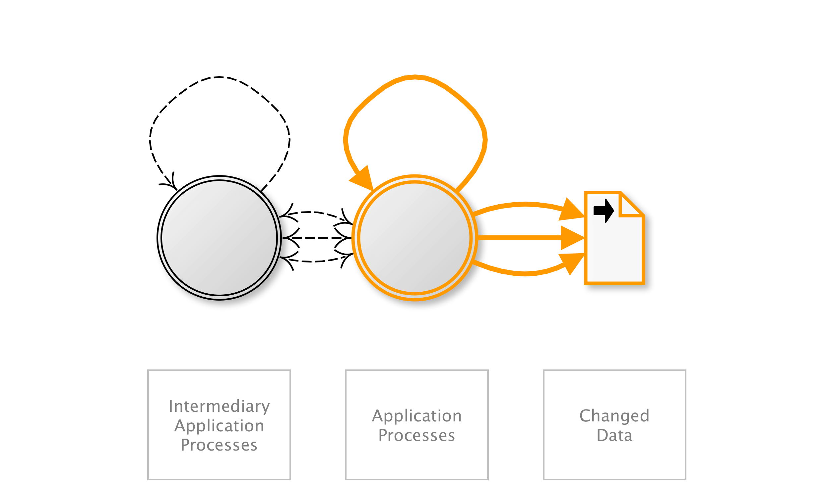
OAT-020 Account Aggregation
Use by an intermediary application to collect together accounts and interact on their behalves.
AKA Account automation; Aggregator; Client aggregator; Data aggregation; Financial account aggregator; Account aggregation; Aggregator; Client aggregator; Data aggregation; Financial account aggregator; Account aggregation; Aggregator; Client aggregator; Data aggregation; Financial account aggregator
OAT-020 Account Aggregation
Notes:
Compilation of credentials and information from multiple application accounts into another system.
Single user to merge multiple applications e.g. all social media accounts.
One application merges multiple user accounts, an example is financial account aggregators.
Look at these. How might AA affect a retail bank?
-
Compilation of credentials and information from multiple application accounts into another system. This aggregation application may be used by a single user to merge information from multiple applications, or alternatively to merge information of many users of a single application. Commonly used for aggregating social media accounts, email accounts and financial accounts in order to obtain a consolidated overview, to provide integrated reporting and analysis, and to simplify usage and consumption by the user and/or their professional advisors. May include making changes to account properties and interacting with the aggregated application’s functionality. For other forms of data harvesting, including the distribution of content, see OAT-011 Scraping. For hastening progress, see OAT-006 Expediting instead.
Financial/Government/Social networking
Many users/Application owner
Authentication credentials/Payment cardholder data/Other financial data/Medical data/Other personal data/Other business data
How might this affect say a retail bank?
Loss of credentials - Customers (account holders) share their credentials with another party, probably in contravention of their contracts. The banks don't trust the to protect the authentication They would prefer the aggregator to use an official API for that purpose. [attack against bank by customer using third party]
2. Leakage and exploitation of PII - The aggregators don't usually charge the account holder for their aggregation service. It is obvious that they monetize their business some other way. They might monetize by taking the PII of the account holder and selling it in some way. [attack against customers by third party]
3. Competition with bank to exploit PII - The banks themselves might exploit the PII in much the same way as #2, this might be their real motive to stop aggregation. [attack against customers by bank]
4. Excessive use of resources - Most aggregation schemes create a highly asymmetrical work load on the bank compared to the aggregator. Because it is cheap and easy to 'poll' the bank's systems, the check often [perhaps hourly] so that their aggregation service is up to date. For the bank this involve queries that hit old IT systems never designed for this kind of query capacity and not easily scalable. [attack against bank by third party]
NEXT
---
Compilation of credentials and information from multiple application accounts into another system. This aggregation application may be used by a single user to merge information from multiple applications, or alternatively to merge information of many users of a single application. Commonly used for aggregating social media accounts, email accounts and financial accounts in order to obtain a consolidated overview, to provide integrated reporting and analysis, and to simplify usage and consumption by the user and/or their professional advisors. May include making changes to account properties and interacting with the aggregated application’s functionality.
For other forms of data harvesting, including the distribution of content, see OAT-011 Scraping. For hastening progress, see OAT-006 Expediting instead.
Financial/Government/Social networking
Many users/Application owner
Authentication credentials/Payment cardholder data/Other financial data/Medical data/Other personal data/Other business data

Slide 43

OAT-020 Account Aggregation
OAT-011 Scraping
OAT-015 Denial of Service
Combinations 1
Notes:
Two threats against the bank, and two against its customers
Perpetrators are customers, third parties (twice), and the bank.
These are described by three different threat events.
Other threats events might also occur in groups....
NEXT
---

Slide 44
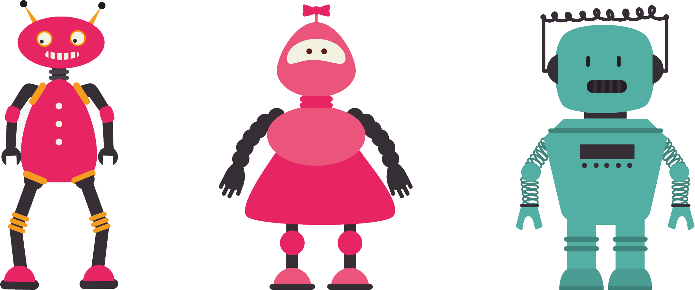
OAT-018 Footprinting
OAT-001 Carding
OAT-012 Cashing Out
Combinations 2
Notes:
So a third party, say organised crime, might footprint a web application looking for payment functionality.
Then if the payment functionality is susceptible, they might use lists of previously obtained credit and debit cards against the process to test for valid cardholder data.
This might be followed by using validated cards to obtain higher-value goods or currency.
NEXT
---

Slide 45

OAT-004 Fingerprinting
OAT-018 Footprinting
OAT-014 Vulnerability Scanning
(vulnerability exploitation)
Combinations 3
Notes:
Another example, which penetration testers might be familiar with are the steps undertaken in application enumeration and potential vulnerability identification.
The attempted exploitation of vulnerabilities is not within the scope of the project or the ontology.
How do the 20 threat events match with other lists?
NEXT
---

Slide 46
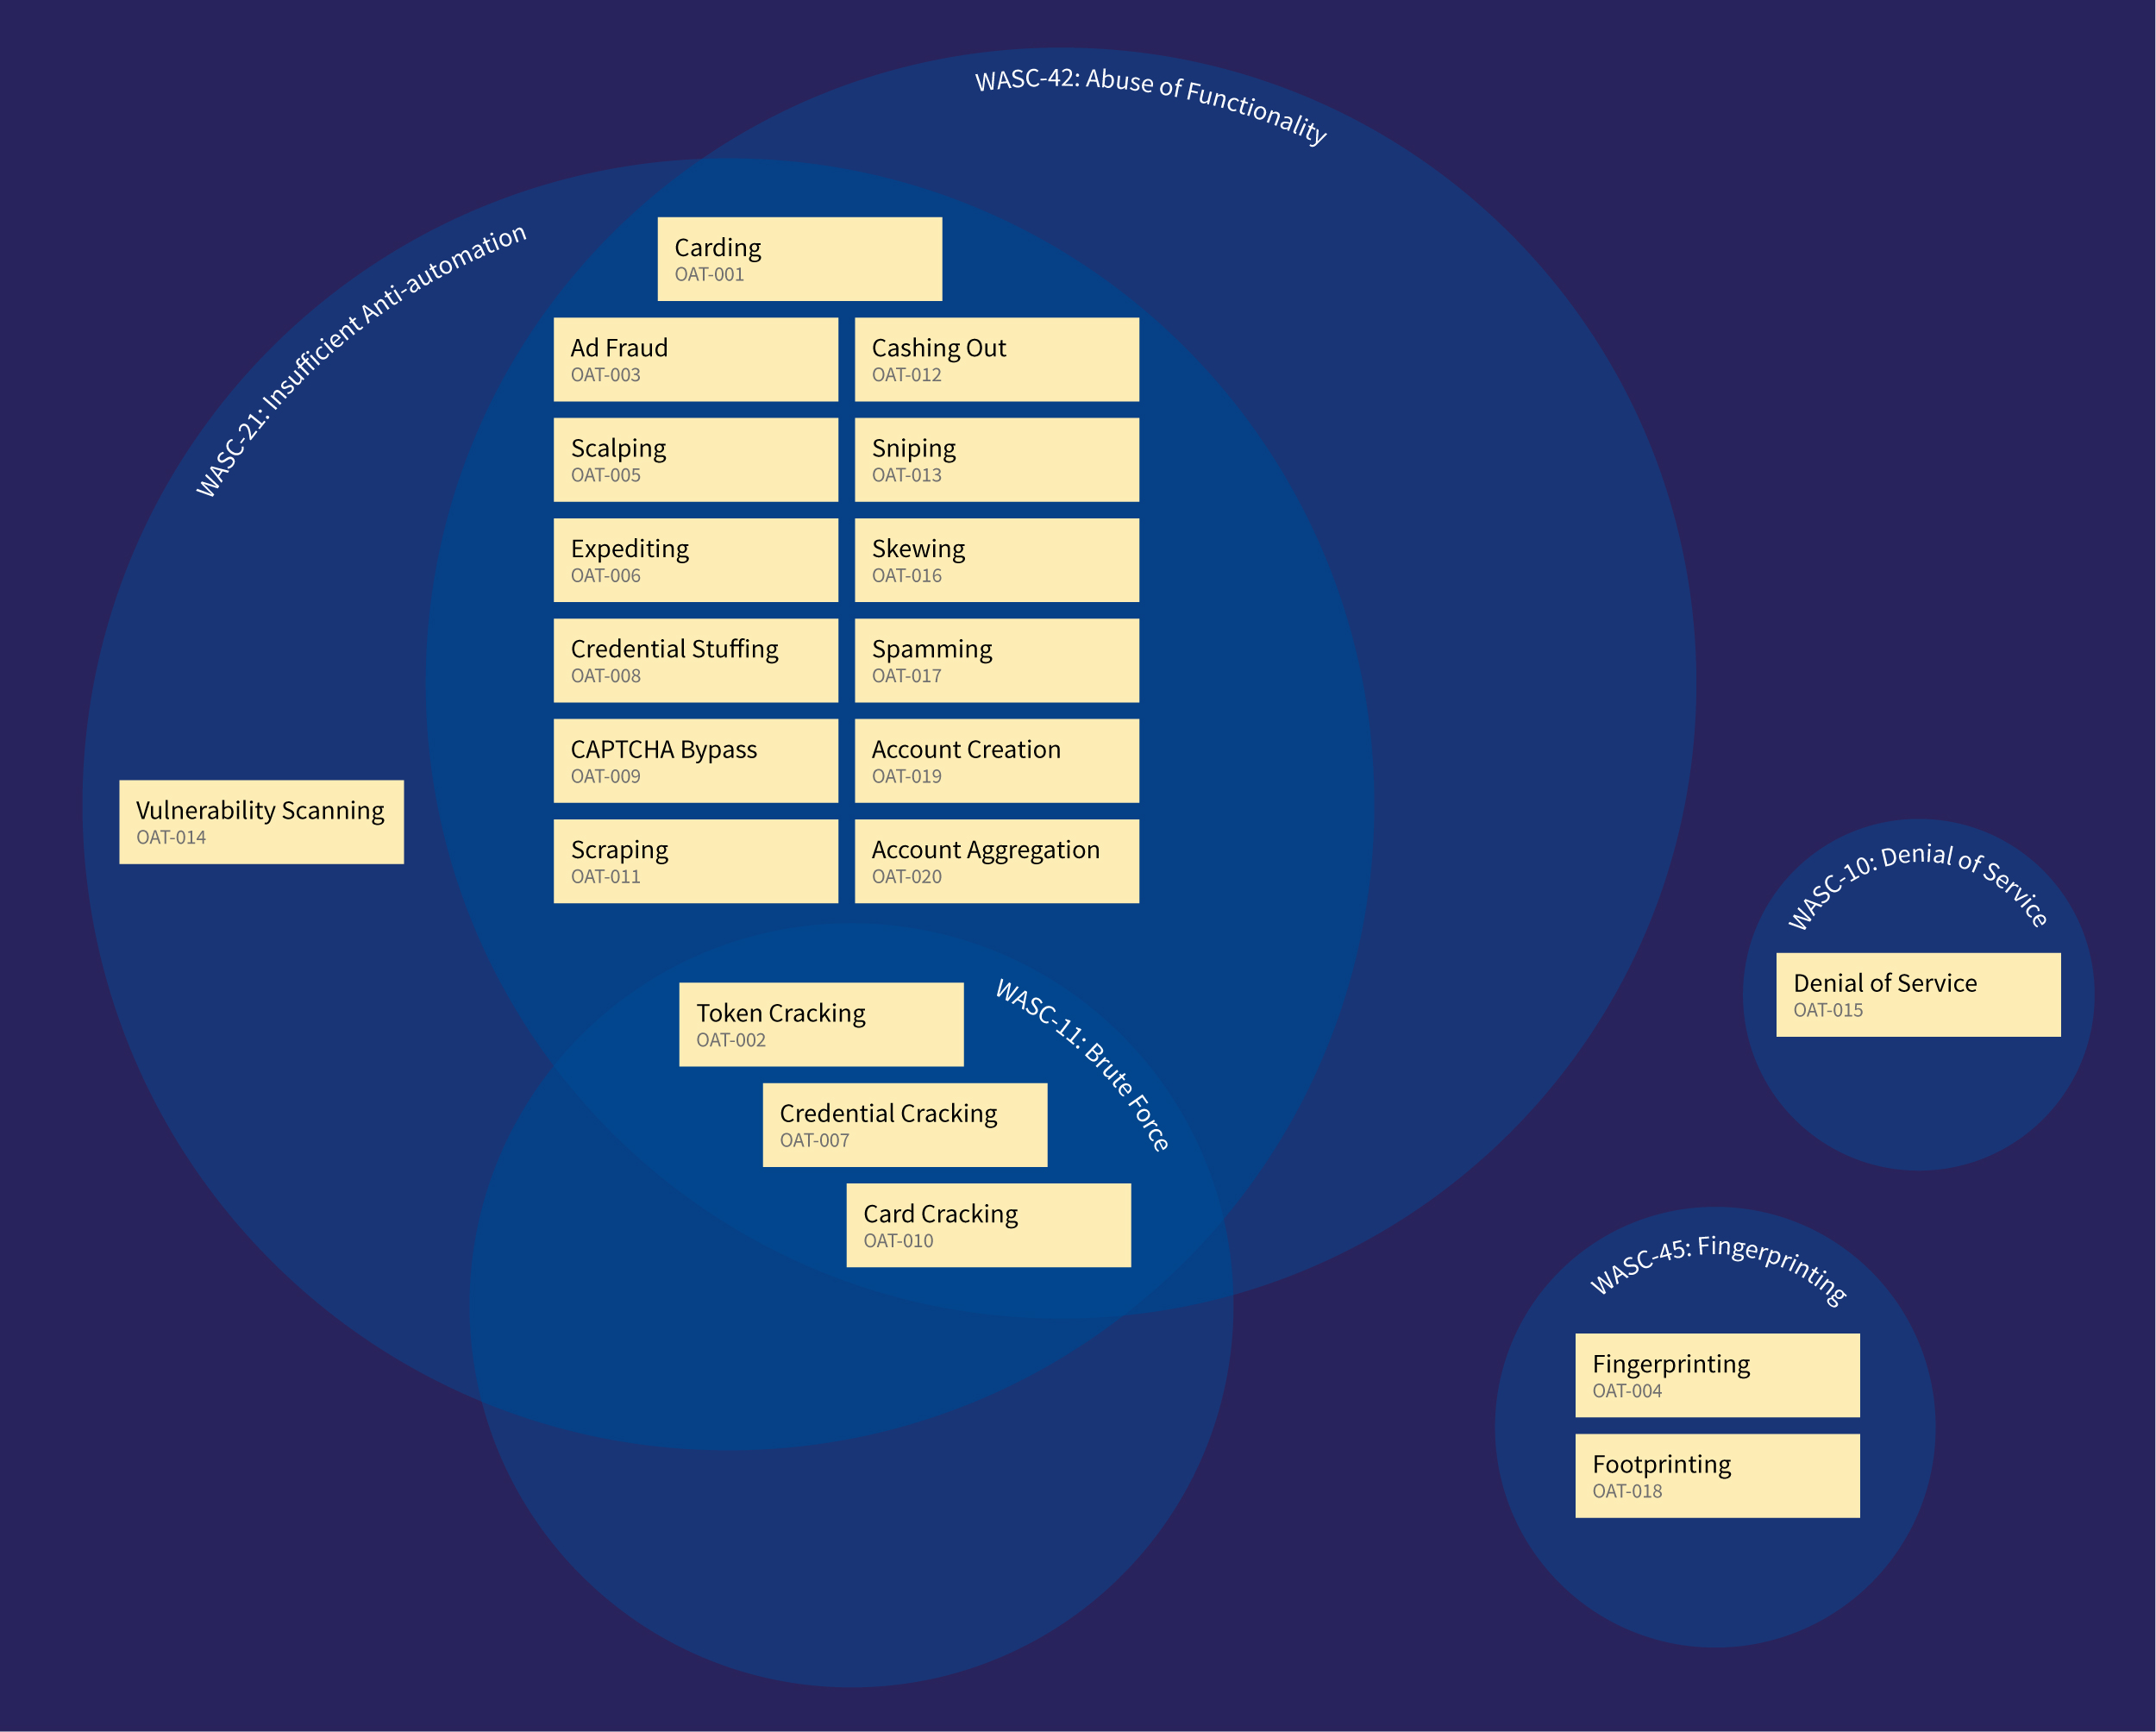
WASC Threat Classification View
Notes:
Web Application Security Consortium – Threat Classification
1. weakness WASC-21 Insufficient Anti-automation and2. the attack WASC-42 Abuse of Functionality.
Three also relate to the attack WASC-11 Brute Force. WASC-45 Fingerprinting includes both OAT-004 Fingerprinting and OAT-018 Footprinting.
Both WASC and this ontology have a unique category for Denial of Service.
-
Coverage relative to the WASC Threat Classification and Mitre CAPEC were examined further to determine how those differ from this ontology.
The majority of the threat events are both the weakness WASC-21 Insufficient Anti-automation and the attack WASC-42 Abuse of Functionality.
Three also relate to the attack WASC-11 Brute Force. WASC-45 Fingerprinting includes both OAT-004 Fingerprinting and OAT-018 Footprinting.
Both WASC and this ontology have a unique category for Denial of Service.
My conclusion, we have expanded the detail of “Abuse of Functionality” / “Insufficient Anti-automation”.
NEXT
---

Slide 47
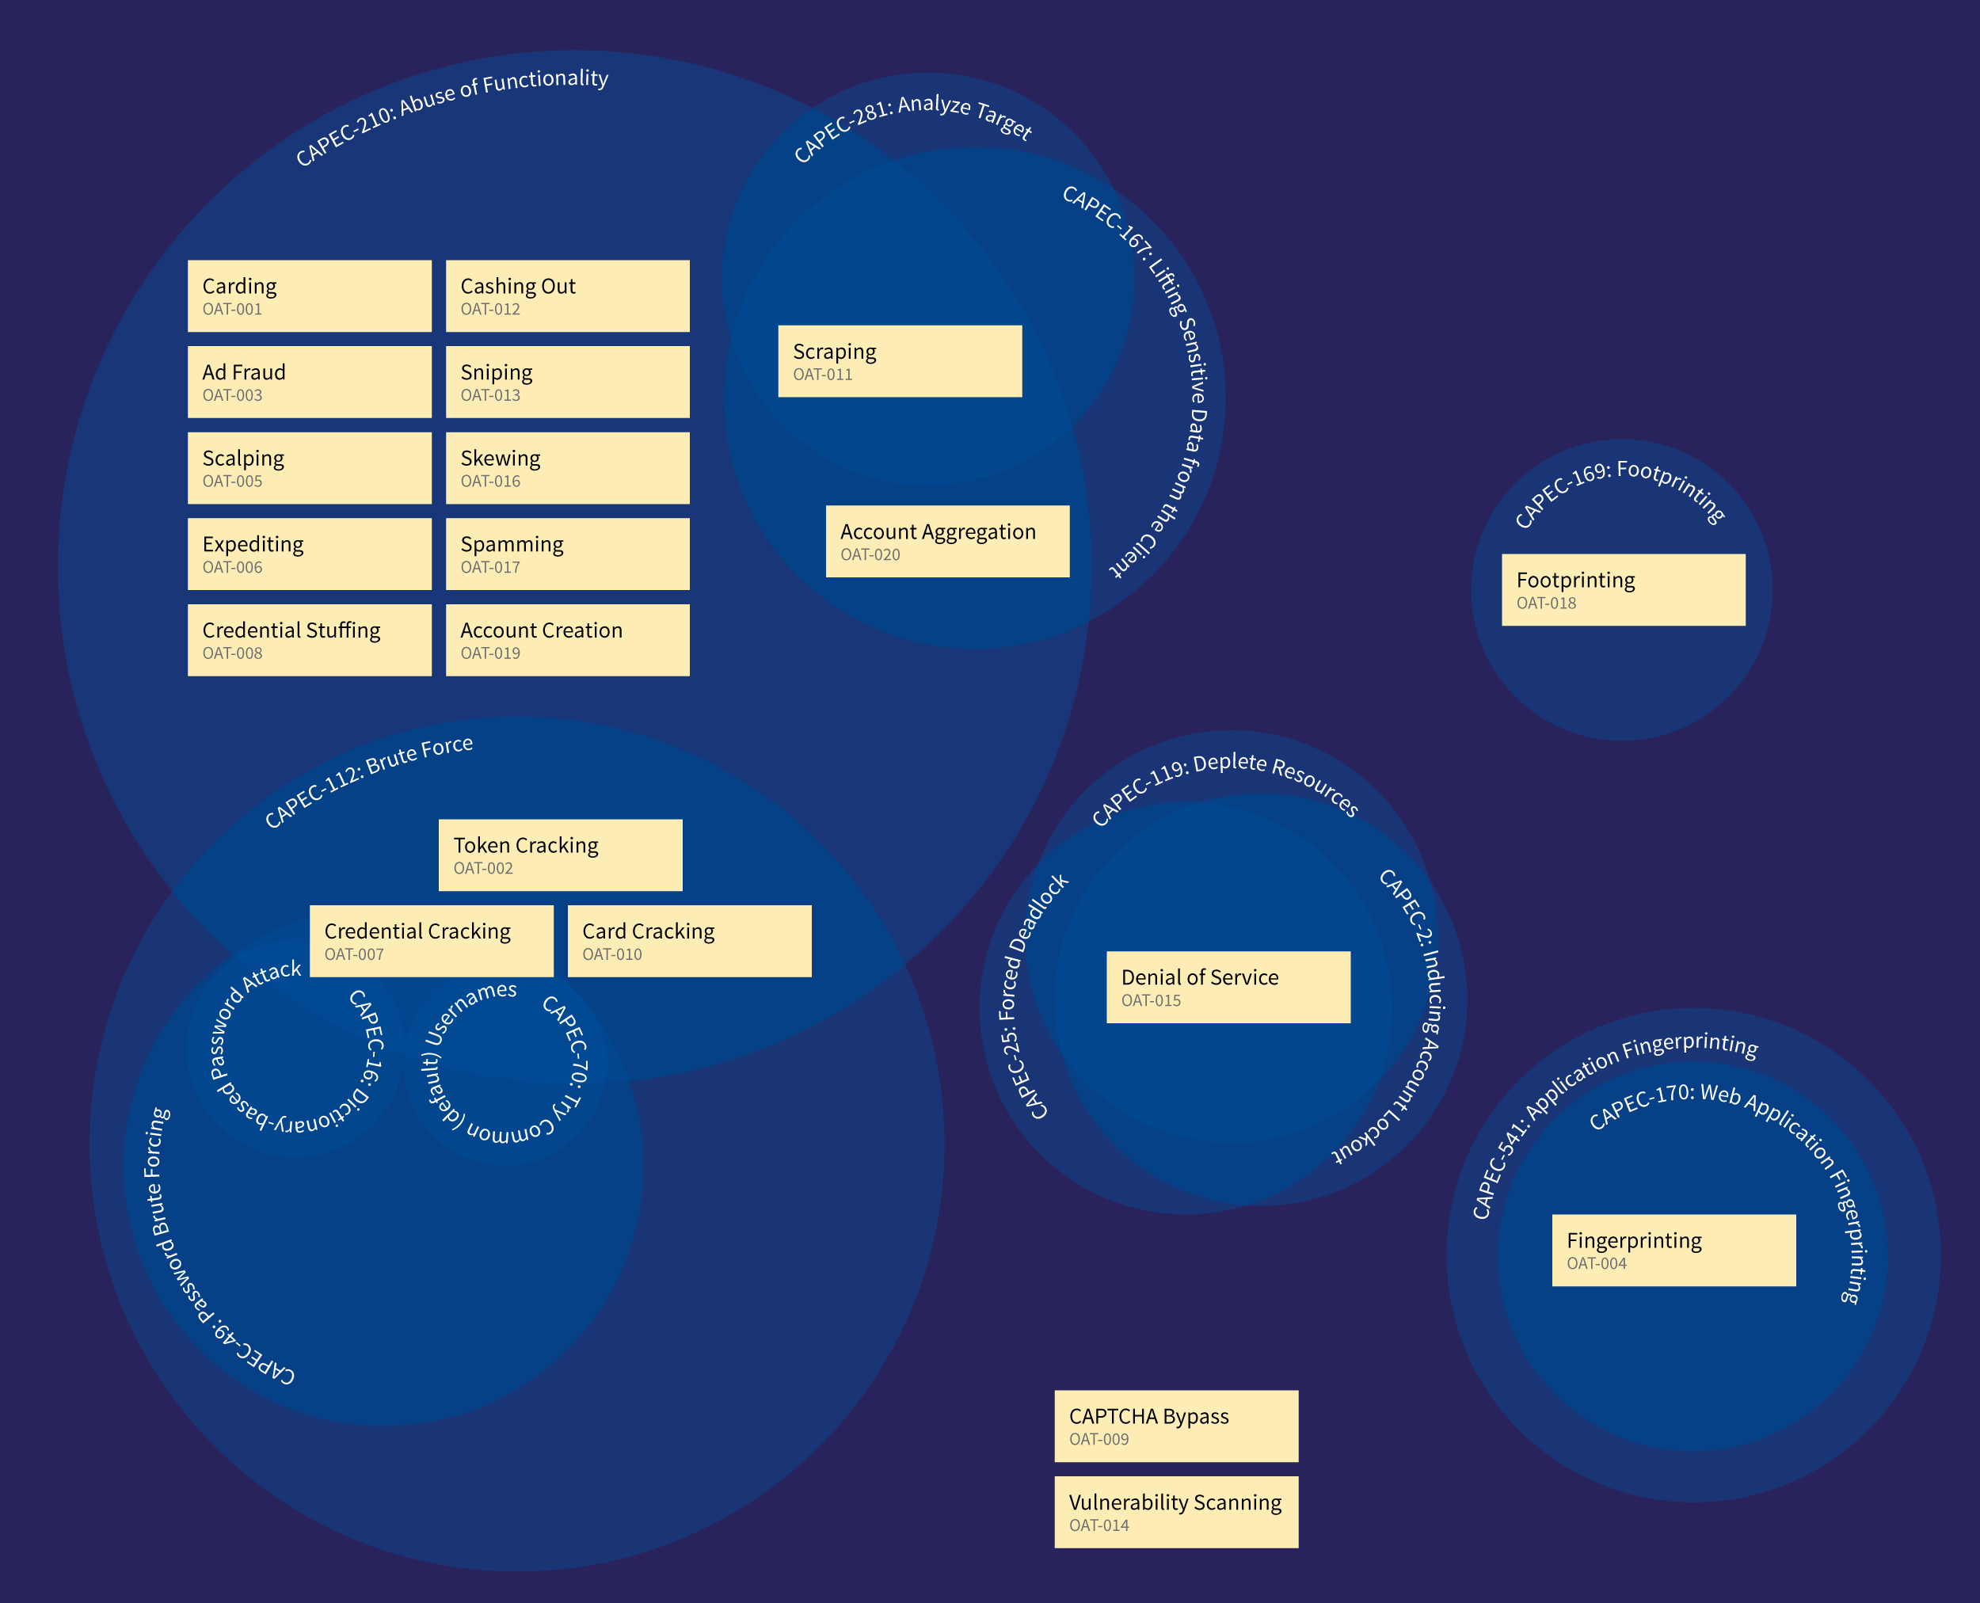
Mitre CAPEC View
Notes:
Common Attack Pattern Enumeration and Classification (CAPEC) is a list of software weaknesses.
CAPEC-210 Abuse of Functionality. CAPEC also has additional categorisations for brute force attacks and denial of service.
Two threat events, OAT-009 CAPTCHA Bypass and OAT-014 Vulnerability Scanning, do not appear to exist within CAPEC.
My conclusion, we have expanded the detail of “abuse of Functionality”.
-
There are many threat events in the CAPEC-210 Abuse of Functionality.
CAPEC also has additional categorisations for brute force attacks and denial of service.
Two threat events, OAT-009 CAPTCHA Bypass and OAT-014 Vulnerability Scanning, do not appear to exist within CAPEC.
My conclusion, we have expanded the detail of “abuse of Functionality”.
...A small number of threat events were removed during analysis and review based on discussions with peers and website owners. The primary reason for removal was either being out of scope, or because the term could not be adequately distinguished from another. Other people may have alternative views on these. The discarded temporary working names and justifications:
NEXT
---

Slide 48
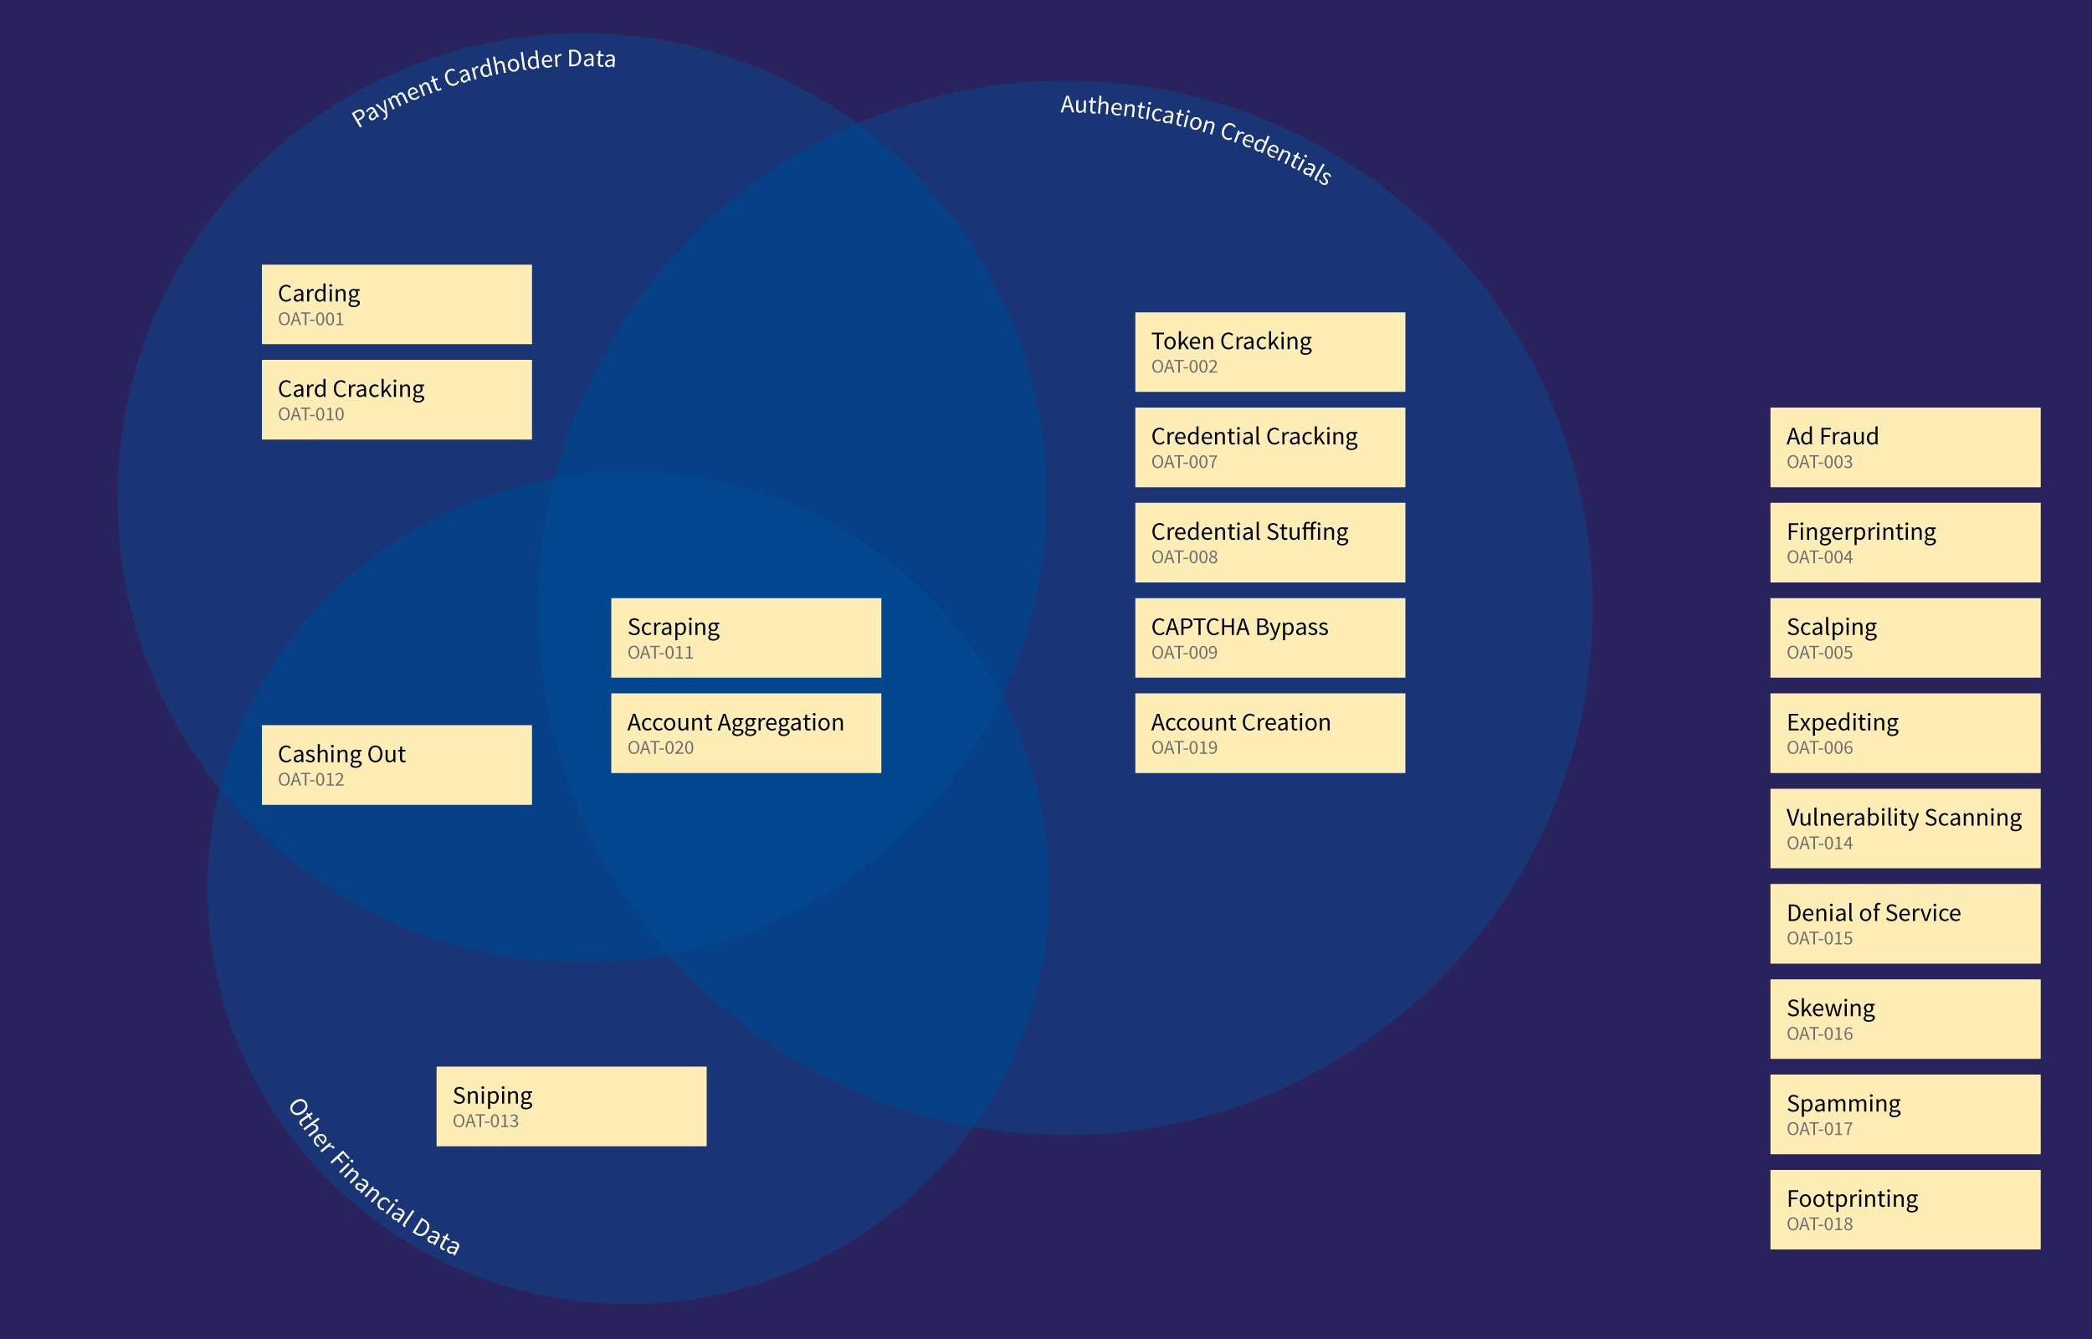
Data Misused View
Notes:
Identified threat events vary significantly in scale, and their timing, duration and frequency can all vary considerably.
Data misused view. Payment cardholder data, other fin data, authentication credentials.
Handbook also lists other types of data.
-
identified threat events vary significantly in scale, and their timing, duration and frequency can all vary considerably.
Data misused view. Handbook also lists and assigns:
Medical data
Other personal data
Intellectual property
Other business data
Public information
All except OAT-015 Denial of Service and OAT-005 Scalping assigned to at least one of these “data commonly misused”.
I was hoping here to provide pointers for those undertaking data risk assessments, to help match against possible threat actors and their capabilities.
NEXT
---

Slide 49
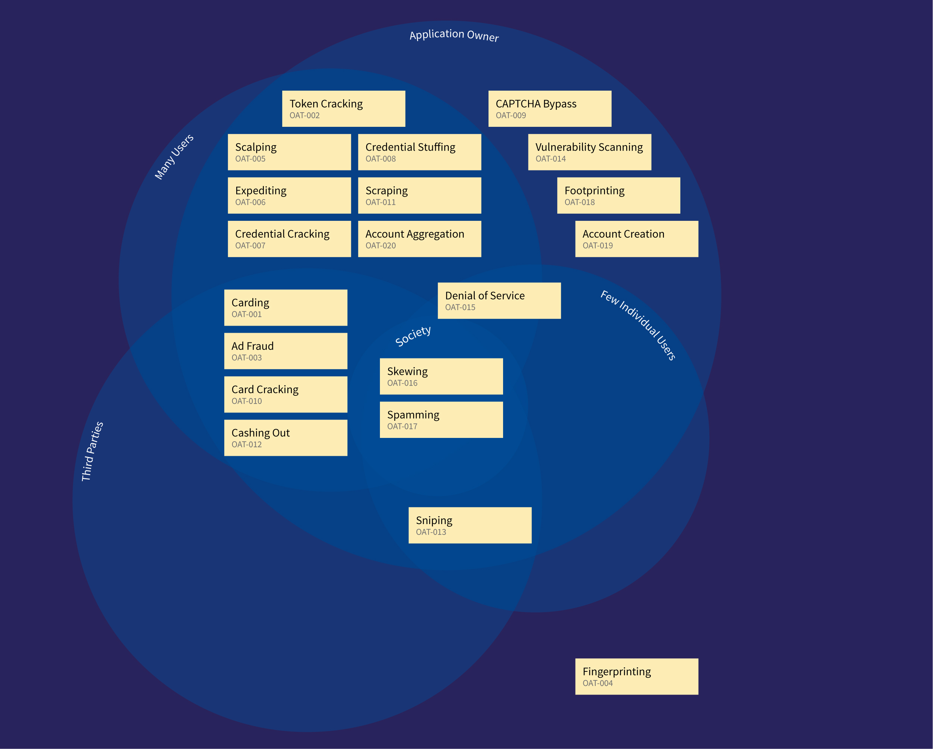
Affected Party View
Notes:
Events related to automated threats can have impacts on more than just the application owner.
Individuals, third parties and even society can be adversely affected.
No ranking in ontology.
-
Events related to automated threats can have impacts on more than just the application owner. Individuals, third parties and even society can be adversely affected. This ontology does not attempt to provide information on, or rank the threat events in terms of impact, since it will be organisation, data, threat actor and victim-perspective specific. An organisation may choose to use its own risk assessment processes to rank these threats for each operational entity, or each market, or even by individual application.
Each threat event is also cross-referenced with:
Mitre CAPEC - best full and/or partial match CAPEC category IDs and/or attack pattern IDs
WASC Threat Classification - best match to threat IDs
Mitre Common Weakness Enumeration - closely related base, class & variant weakness IDs
Matching pages defining terms classified as attacks on the OWASP wiki.
We will look at these shortly, but first let me run through a few detailed threat events.
NEXT
---

Slide 50
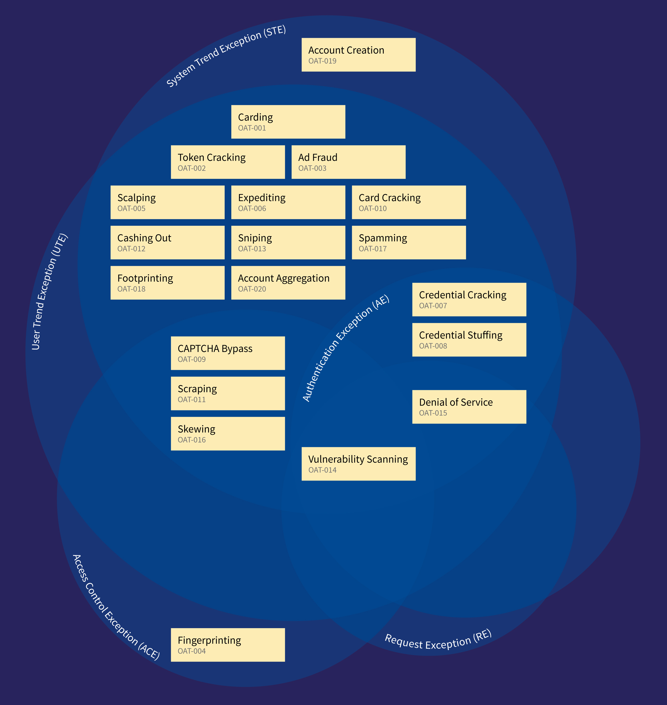
AppSensor Detection Point View
Notes:
Returning to one of my original questions, what AppSensor detection points might help, I had a look at how the identied threat events might map to AppSensor Detection Points.
Mainly User and System Trend Exceptions categories
14 Vulnerability scanning – also in: Session Exception (SE), Input Exception (IE), Encoding Exception (EE), Command Injection Exception (CIE)
Not included: File input/output exception (FIO), Honey trap (HT), Reputation (RP)
NEXT
---

Slide 51

AppSensor
https://www.owasp.org/index.php/OWASP_AppSensor_Project
John Melton at AppSec USA 2015
Tomorrow Friday at 2pm
Room C
John Melton
More About AppSensor
Notes:
If you want to hear more about AppSensor, you might want to attend a presentation tomorrow afternoon here at AppSec USA.
NEXT
---

Slide 52
Let’s update the risk assessment, after
reviewing our threat event detection capabilities and possible additional mitigations based on the OWASP Automated Threat Handbook
We are seeing a growth in OAT-020 Account Aggregation, as defined in the OWASP Automated Threat Handbook
We have a new cloud service that complements your own mitigations for OAT-020
We can raise OAT-020 at the next Cyber Intelligence Sharing Group
Yes, marketing have some data about customer disengagement that supports this
What new products or services might help?
Information Security Manager
Chief Operating Officer
Vendor Sales Rep
Problem Definition Revisited
Notes:
And, returning to one of my first slides... with the ISM and COO....
CLICK The dialog can use defined terms (and possibly codes)
CLICK Information from other parts of the business can reference these
CLICK Risk assessments can use the threats meaningfully CLICK
And of course, if Aladdin rubs the lamp,
CLICK ...maybe in a future world vendors will appear
CLICK ... armed with evidence how they can specifically address the particular problems.
NEXT
---

Slide 53

Automated Threats to Web Applications
https://www.owasp.org/index.php/OWASP_Automated_Threats_to_Web_Applications
Wiki content
Summary
Scope and definitions
Bibliography
FAQs
Roadmap
Getting involved
Malicious Automation
OWASP Project Details
Notes:
All the materials and information are published on the OWASP wiki at this address.
Like all OWASP outputs, everything is free and published using an open source licence.
Or search “automated threats”.
NEXT
---

Slide 54

Threats
Prevalence data
Symptoms
Identification metrics
Mitigations
Guidance for builders
Guidance for defenders
Effectiveness of controls
Sector-specific guidance
You
Roadmap
Notes:
In the printed handbook, each threat event is given two page. On the first page are
On the reverse.... just possible symptoms. Would like prevalence data (by sector?) and tried once unsuccessfully to obtain this by a survey.
Want to add:
Mitigations for designers, developers and operators - including guidance for builders and defenders
Threat identification metrics
NEXT
----

Slide 55

To Do: Mitigations
Notes:
For mitigations...
Some mitigations may be generic anti-automation controls (shown in the middle of this diagram), but there are also threat-event specific mitigations, or mitigations that are only relevant to a subset of threat events (overlaps in diagram)
NEXT
---

Slide 56

To Do: Perpetrators
Notes:
Who is perpetrator? Threat agent. Attacker? Not always some malicious group…. Here is a wider list I use.
Users – the citizens, clients, customers, employees (jntranet application) and even administrators, who might automate their tasks
OAT-020 Account Aggregation e.g. giving their credentials to a third party aggregator
OAT-011 Scraping e.g. non-malicious but unapproved use such as report creation
OAT-006 Expediting e.g. to automate the completion of earlier steps in a game
Application owners can be a threat too
OAT-003 Ad Fraud to raise revenue
OAT-015 DoS by self-inflicted monitoring, reporting, etc)
-
One categorisation I had considered attempting to create is the perpetrator, sometimes who might be called the “threat agent” or “attacker”. Contrary to the illustrations, it is not mechanical or digital machines that are the source of the threat but humans. As my manager in my first job said “It’s not the people who fire the guns you have to worry about, it’s the ones who make the bullets”.
Here are some possible attackers, commonly used in threat risk assessments. You will notice some which you might not always include in a typical information security risk assessment:
Users – the citizens, clients, customers, employees (jntranet application) and even administrators, who might automate their tasks
OAT-020 Account Aggregation e.g. giving their credentials to a third party aggregator
OAT-011 Scraping e.g. non-malicious but unapproved use such as report creation
OAT-006 Expediting e.g. to automate the completion of earlier steps in a game
Application owners can be a threat too
OAT-003 Ad Fraud to raise revenue
OAT-015 DoS by self-inflicted monitoring, reporting, etc)
But I realised that the motivations and objectives for each threat event could vary widely depending upon the data and the threat actor. This might be of more use ion sector-specific industry vertical guidance.
NEXT
---

Slide 57

Colin Watson
Jason Chan, Mark Hall, Andrew van der Stock
Everyone else who contributed information anonymously, and the information from the reference sources used
OWASP Foundation
Colin Watson
Acknowledgements
Notes:
Before I finish speaking, I would like to thank some people.
All mistakes, errors and anything that causes controversy are my own – spotted some typos already, so will need to issue 1.01
Some people contributed but don’t particularly want to be named, but these people did help. Thank you to everyone, no matter what you provided. It is still largely my own work and therefore I would welcome additional help as described previously.
NEXT
---

Slide 58

Questions
Now
This evening at the social event
Tomorrow during the conference
Project mailing list https://lists.owasp.org/mailman/listinfo/automated_threats_to_web_applications
Paperclip+
Questions
Notes:
We have some time now, but immediately at 2pm I have to move to Room E to provide a lightning training session.
I will be around this evening during the conference cruise, and also tomorrow.
[Q&A]
Please also use the project’s mailing list to ask questions or make contributions.
STOP!!!!
---

Slide 59
And finally
Notes:
Books this evening
Musée Mécanique - world's largest privately owned collection of working coin-operated mechanical musical instruments and antique arcade machines
Room E -> Cornucopia card game lighting training

